Slide 1
Thinking to Writing…
Clare Brooks and Andy Flaherty
St. Louis March 12, 2014

Slide 2
I Can…
connect my thinking with my writing.

Slide 3
Purpose
Activity focuses on specific skills – brainstorming and writing
Thinking is extended beyond individuals to groups and then back to individuals – cooperative groups
The process of thinking and writing are connected - application
Specific actions are required at each stage of the activity
As the result of the work, students are asked to draw conclusions
Rigor is achieved through accountability

Slide 4
Cooperative Groups
Move to the group indicated on your paper.
1, 2, 3, 4, 5
Locate the person who has a Pink Dot on their card (spy)
Using your ABC Handout brainstorm
Words or phrases the define or explain differentiation

Slide 5
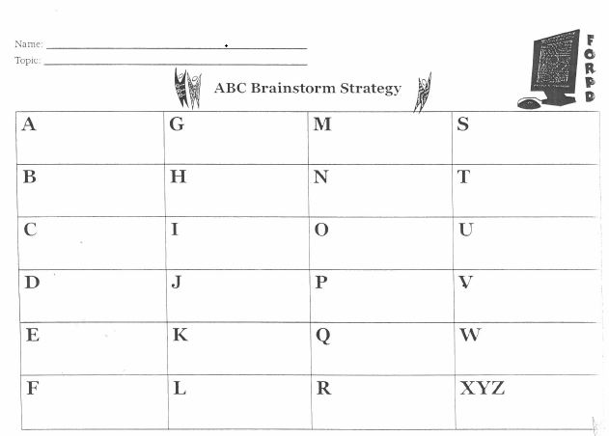
Brainstorm Differentiation

Slide 6
Reach Consensus
Groups Re-read their alpha list and:
Prioritize the 5 most important words and phrases about differentiation
Circle them on your papers

Slide 7
Write a Summary
Each person writes a summary that includes:
1 sentence that introduces the topic
2 to 3 sentences that identify the most important components of the topic
1 sentence that draws a conclusion
Use an objective voice

Slide 8
Conclusion
Turn to your group members and talk about a subject you are teaching in the next two weeks and where you could incorporate this strategy.

