Slide 1
Reading Instruction Variables
Andy Flaherty

Slide 2
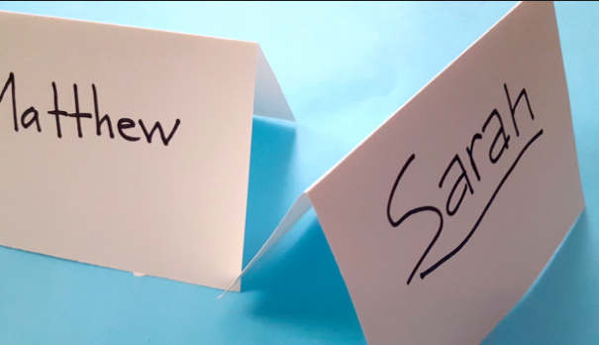
Temperature Check
Please Create a Table Tent
Below your name Indicate your feelings about data by writing a word that summarizes your comfort level:
Warm Neutral Cool
Notes:
Andy

Slide 3
Norms
Be Fully Present
Speak Your Truth
Push Your Thinking
Equity of Voice
Notes:
Jenn

Slide 4
Outcomes
Rethink the way you plan your reading instruction
Begin to see overlap between guided reading and close reading
Opportunity to share best practice thinking with a colleague
Gain two new strategies you can use immediately

Slide 5
Paradigm for Data Analysis
Strategize
Delineate
Synthesize
Justify
Organize
Notes:
Andy

Slide 6
Paradigm Questions
What do you want to accomplish?
What data sources did you use?
Where are you in the curriculum?
What did the data tell you?
What are the patterns that emerged?
What do you need to adapt?
Strategize
Delineate
Synthesize
Justify
Organize
What do student artifacts indicate?
Is student growth evident?
Notes:
Andy

Slide 7
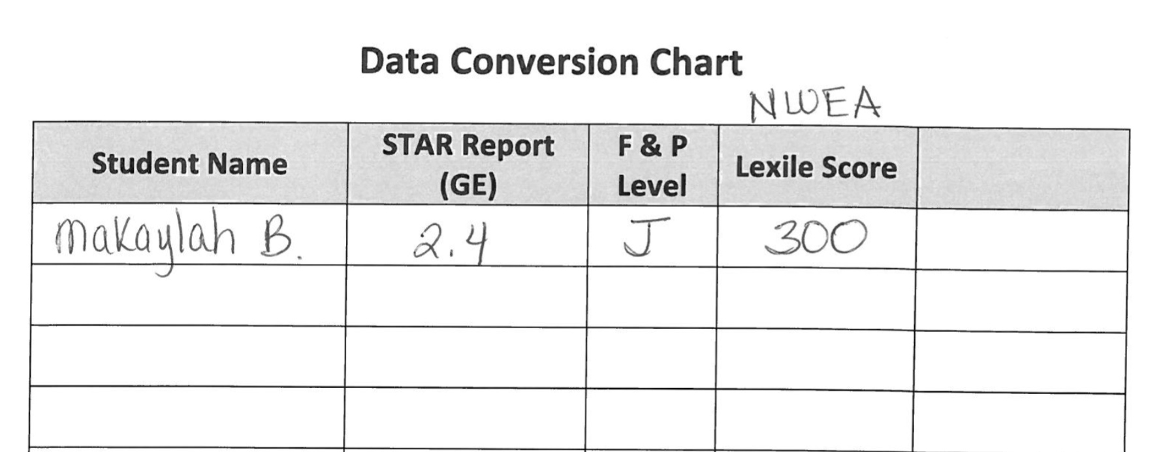
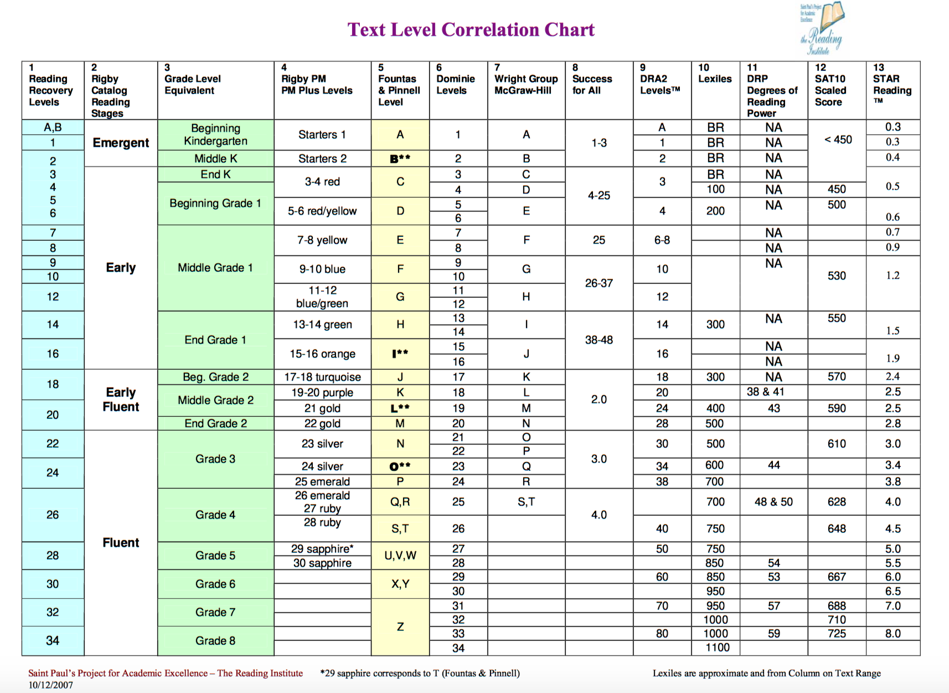
Delineate
What is your data source?
What patterns emerge?
A
Pull up data : Star Data
Convert to Lexile Level then F&P
Complete guided reading group chart
C
B
Lexile Conversion Chart
Notes:
Data delineation using Star

Slide 8
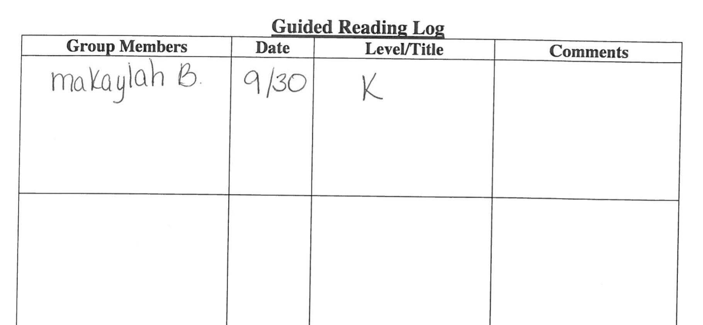
Synthesize
What did the data tell you?
What do you need to adapt?
E
Create groups.
Schedule for when groups meet
F
D
Notes:
Creating a group schedule based on curriculum

Slide 9
Organize
Teacher System
Student System

Slide 10
Differentiation: The FoRMATIVE Assessment
Share a GLOW and a Grow
STUDENT DATA SOURCES
Interactive notebook (system)
Short answer test
Open response test
Frayer 4-square
Oral response
Portfolio entry
Exhibition
Culminating product
Question writing
Problem solving
TEACHER DATA MECHANISMS
Data Binder (system)
Anecdotal records
Observation by checklist
Skills checklist
Class discussion
Small group interaction
Teacher – student conference
Assessment stations
Exit cards
Performance tasks and rubrics
Notes:
Jenn

Slide 11
Differentiation
Instruction
Curriculum
Assessment
Classroom
Notes:
Andy

Slide 12
Differentiation: The Instruction
A teacher’s response to leaner’s needs guided by general principles of differentiation
Flexible Grouping
Continual Formative Assessment
Appropriate Tasks
Respectful Rigor
Curriculum Compacting
Turn and Talk: Where do you want to grow?
Notes:
Andy

Slide 13
Literacy Instruction Best Practices
Guided Reading Groups
Prioritize non-fiction
Meet with lowest group daily/other groups twice a week
1st Read: Guided; 2nd Read: Close Read
Track student behaviors to notice and support
Notes:
Jenn/Andy ; 15 minutes

Slide 14
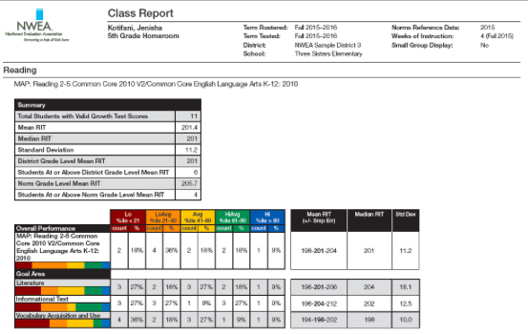
Create Synergy
Notes:
Andy, find connections

Slide 15
Think Aloud
The goal is to modify or “streamline” curriculum to allow students to move at a quicker pace and then have time to pursue an alternate topic or go into greater depth in an area of study.
Notes:
Screenshot: think aloud Andy

Slide 16
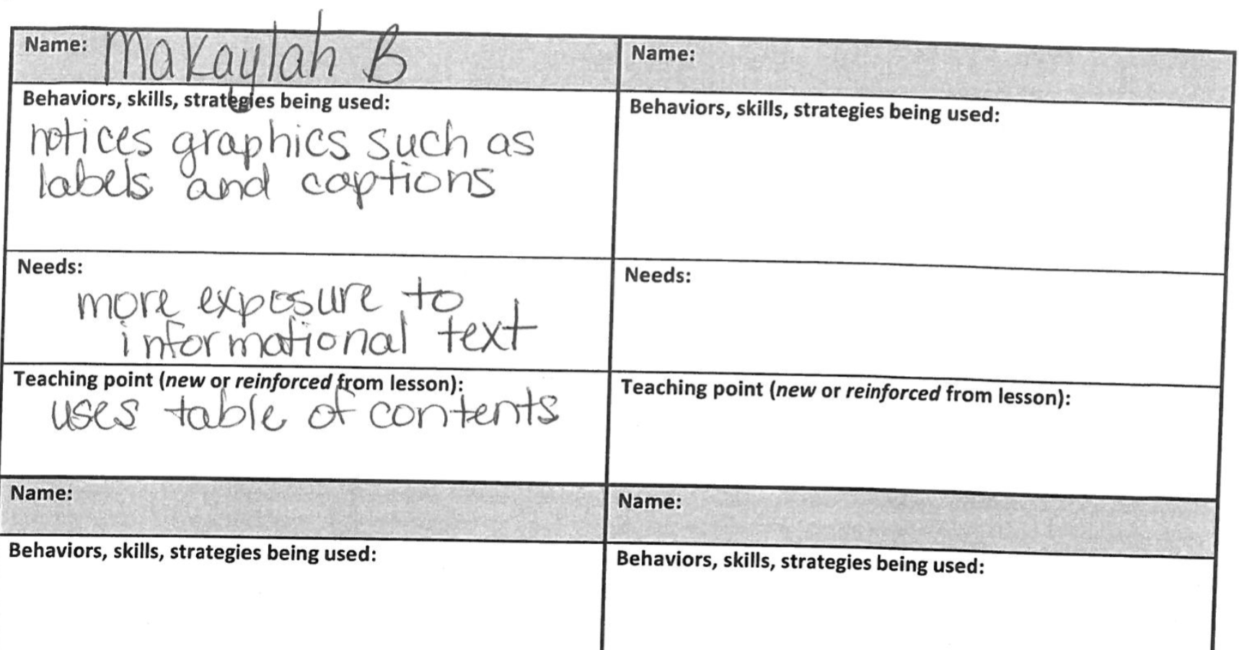
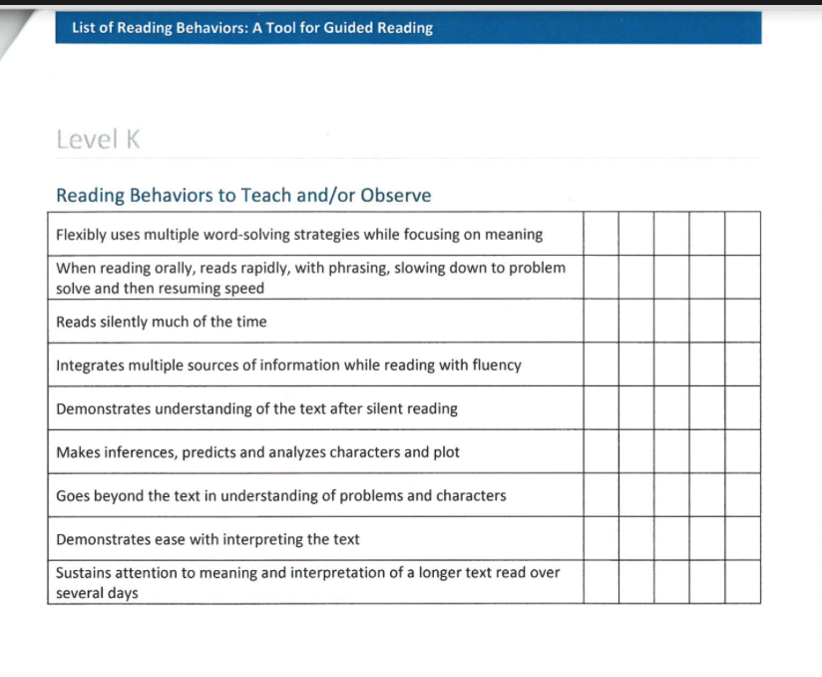
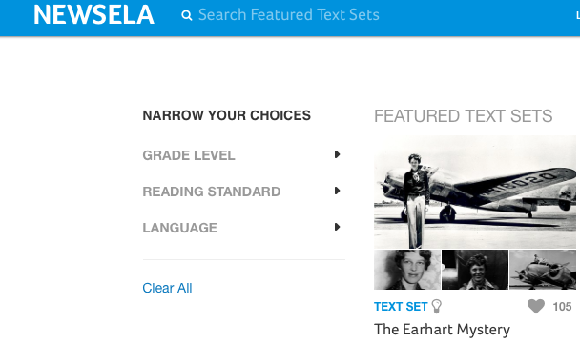
Synthesize
H
What will you teach?
What resource will you leverage?
How will you organize it?
Already done in SIS for you
Differentiate lexiles based on group lexiles
G
g
Notes:
Andy

Slide 17
DIFFERENTIATION: The CURRICULUM
CURRICULUM
1) What’s important?
2) What does my formative assessment indicate?
3) What can be skipped or eliminated?
4) What do you need to add?
Notes:
Andy

Slide 18
Close Reading

Slide 19
InstructionAl Approach: Balanced Literacy

Slide 20
Guided Reading

Slide 21
Groups

Slide 22
Group Types

Slide 23
Video of DIVERSE LEARNERS
https://www.teachingchannel.org/videos/teaching-diverse-learners
Notes:
Activity

Slide 24
The Experts on Guided Vs. Close REading
“Guided readings says go easy, and common core says challenge them (students).”
Close Reading is a process and guided reading is a continuum of strategies that can be used for students with varying degrees of skill.
Notes:
Close Reading is a process… guided reading has strategies

Slide 25
Experts
“At the end of the day, the disagreement is philosophical rather than empirical – it is about the desirability of teaching. If you think it is better for kids to figure things out with minimal scaffolding, then is makes sense to control the degree of challenge; too much difficulty would only lead to failure and frustration. However, if, on the other hand, you think it is okay to provide students with as much support as they might need to engage successfully in a particular task, then limiting difficulty too much would reduce the opportunity to learn.” - Tim Shanahan

Slide 26
Guided or Close
How do they differ?

Slide 27
Reading Behaviors
Behaviors Guided Reading
Behaviors Close Reading
Select texts to expand processing strategies
Prepare an introduction
Listen orally and interact with individuals
Talk about text, assess students understanding
Focus on Tier I words
Focus on Comprehension
Engage students in the problems/problem solving
Return to text multiple times for teaching opportunities
A PROCESS
Teacher does not provide background
Provide students with a focus/purpose
Students are “text detectives”
Read and re-read deliberately
Focus on Tier II words
Focus on particular words and phrases
Students present thinking
Outcome based PRODUCT

Slide 28
Lesson Planning Workshop
Think-Pair-Share
1. Read the speech and underline the claim/evidence
2. Briefly discuss with your partner
3. Compare the standards to the reading and determine 2 standards to focus on.

Slide 29
Compare Standards to Text
Standards/Lexile
Text Itself
Notes:
Side by side: Andy intermediate; Jenn primary

Slide 30
DifFERENTIATION: Snapshot (7th Grade Classroom)
Student A Demographics
GE: 5.4
NWEA reading score: 207
Grade on Report Card: c
Student B Demographics
GE: 7.0
NWEA reading score: 226
Grade on Report Card: A
A Day in the Life of:
Minutes | Lesson Component | Student A | Student B
5 | Bell Ringer | Understanding Confusion | Independent reading when you finish
10-15 | Mini Lesson | Read and annotate M= main idea, S = supporting details Close Reading
30 | Independent Practice/Small Groups
3 | Exit Slip
Notes:
Andy

Slide 32
Planning Your Lesson - 14 minutes/10 minutes
With your partner, create a lesson plan
Consider the Vocabulary Web , Argument Graphic Organizer close reading vs. guided reading
Consider bell ringer and exit slip
Complete lesson plan template
Select which partner will present – 2 minutes each

Slide 33
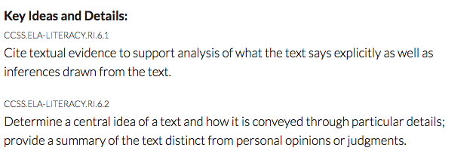
Classroom Simulation
Bell Ringer
Notes:
Side by side: Andy intermediate; Jenn primary

Slide 34
Bell Ringer:
“Most Difficult First”
Part A.
Which mood is best revealed in the passage?
A. dismal
B. hopeful
C. cold
D. uninteresting
Part B.
Which text evidence best indicates a mood to the reader?
A. “absolutely unselfish friend that man”
B. “a man’s dog stands by him”
C. “where the wintery winds blow and the snow drives”
D. “he will sleep on the cold ground”

Slide 35
MINi-Lesson: Argument
Main Idea?
“Most Difficult First”
Argument = claim
Reasons = statements that explain the claim
Evidence = facts that support the reasons
Notes:
Frayer Model Graphic Organizer

Slide 36
Students Read Speech Twice
Using Building an Argument Graphic Organizer – I do, We do, You do (homework)
Second day, go deeper with vocabulary using word webs and homogeneous groups
Re-read with new vocabulary in place

Slide 39
Exit Slips
The purpose of an exit slip is to measure the degree to which students have moved toward mastery of a given standard during your lesson.

Slide 40
Journey’s Curriculum
Tips to increase rigor and embed constructed/extended response weekly:
Select 2 questions from the weekly assessment that are not rigorous
Rephrase the questions, whereas students have to provide a claim, evidence, and reasoning.
Accountable Talk
When you rephrase questions, try to use released question stems from Measure Up or State Test Released Items
Example:
4. Using textual evidence, discuss what Miss Franny’s father gave her for her birthday?
Miss Franny received a library for her birthday. The text states, “So I told him, I said, “Daddy, I would certainly love to have a library for my birthday, a small little library would be wonderful” This quote informs me that she wants a library. I know that a library stores a collection of books, so I think she wants books. The quote “I wanted a little house full of nothing but books, I wanted to share them. And I got my wish, My father built me this house”. This quote confirms that she wanted books, and her father built her a house to store the books. When a collection of books are stored in a central location, it is called a library.
Notes:
Jenn

Slide 41
`
Major shifts in how ELA/SS questions are asked
Students are asked to provide cited text evidence.
Students are asked to select multiple correct answers
Journey’s Curriculum Content Resource
Notes:
Andy

Slide 42
Try to grade constructed-response rubrics similar to how students will see on end of year assessments.
Try to keep grading scores consistent for entire school year.
Genre specific rubrics are an optional choice too (e.g., opinion, informative, etc.)
Notes:
Jenn

Slide 43
The Differentiated Instruction
Share out your 2 commitments for the school year
Flexible Grouping
Continual Formative Assessment
Respectful Tasks
Appropriate Degrees of Challenge
Curriculum Compacting
What will you change TOMORROW?
Notes:
Andy

Slide 44
THANK YOU!
Notes:
Andy

