Slide 1
Lesson Planning
Concept Schools’ 2017

Slide 2
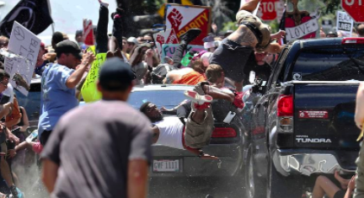
APPROACHING THE
DIFFICULT?

Slide 3

Media and Viewing

Slide 4
What makes a good lesson Plan
Brainstorm

Slide 5
Both of these texts will Fit
Essential Question: How does my response to change impact who I am?
PBA write an argument or participate in a panel discussion.
Standards
  Media/Visual Literacy
  Reading Information standards…
  Depending on where the unit falls in the year you will need to connect it to your schools focus standards?

Slide 6
Begin With Text
How do you create text dependent questions?
How do you stop n think about what you are seeing?

Slide 7
Connect Stop-N-Think to a Hypothesis
At the intersection of Science and Art is awe
Is a hypothesis a claim?

Slide 8
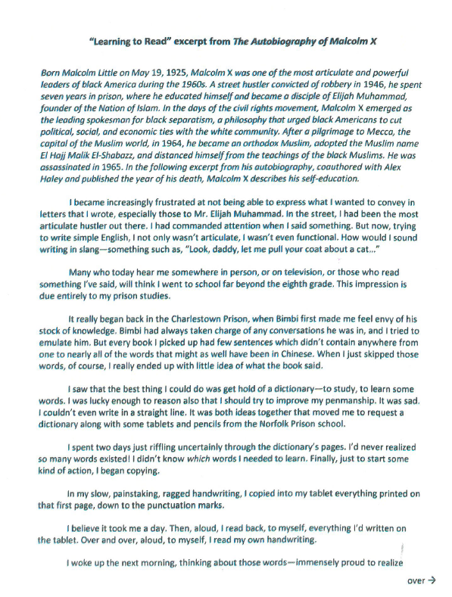
Begin With Text
Why are you teaching it?
What does it exemplify?
What type of text is it?
Does it fit the unit essential question? How?
Can it become a mentor text?

Slide 9
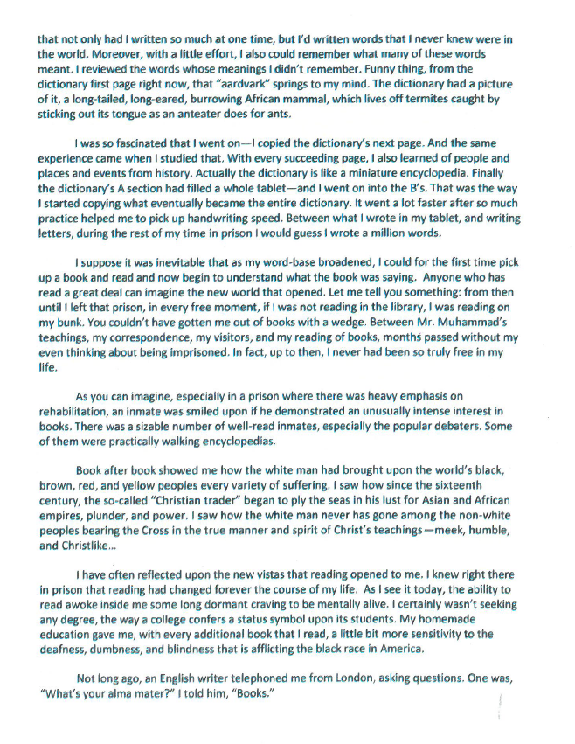
Notes:
What do you notice about the text structure?

Slide 10
First annotate text – part to whole
Number paragraphs… trick, exclude the background
Key words or transitions for the type of text
Identify problematic words

Slide 11
Pick one:
  Use text to teach problem solving
Use text to teach methodology and/or habits of mind

Slide 12
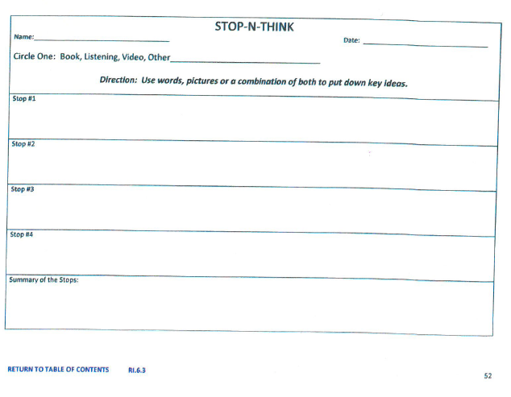
Research-Based Strategy
Notes:
What other ones do you need?

Slide 13
Partners
1. Create a lesson plan/poster for the Essay
  Standards - 2
  Bell Ringer
  Activity/Research based strategy – with steps
  Exit Slip

Slide 14
Excerpt from Malcom X

