Slide 1
Concept English Expectations 2013-2014
aflaherty@conceptschools.org

Slide 2
Education Week says…
“The common core means that teachers must shift their practice and teach more advanced materials to their students in more successful ways. How can we accomplish such a substantial change in classroom instruction in thousands of schools and tens of thousands of classrooms, and with millions of students with differing abilities, interests, and life goals? We believe the answer lies in two key strategies: greater teacher collaboration and better instructional planning and delivery.”

Slide 3
Collaboration is…

Slide 5
Some thoughts…
Ensure teachers are building a mutual respect for one another
Establish norms so teachers are free to disagree respectfully without offending each other
Enhance your school culture by supporting individual learning styles and approaches while promoting collaboration
Remind teachers that his/her work is built upon a continuum that evolves over time and grade

Slide 6
ELA Goals for Orientation
Make clear that teachers are to:
Use Atlas for unit and lesson plans
Read Concept ELA Units and, if necessary, make modifications
Co-plan and collaborate
Strive to achieve best practice
Work toward balanced/disciplinary literacy integrating reading and writing instruction with…

Slide 7
Orientation Expectations
I. Director facilitates 3 sessions
II. ELA Department reviews expectations
III.ELA Department reviews Reading for Information strategies and determines two to master
IV. ELA Department develops scope and sequence working collaboratively (see form)
V. ELA Department reviews writing assessments/revised/resubmits (see form)

Slide 8
Orientation Expectations…
I. Director facilitates 3 PD sessions
A. Overview
B. Balanced Literacy and CCSS
C. Science Reading and Writing – Disciplinary Literacy
Notes:
Four other areas we want ELA teachers to be working on Orientation week.

Slide 10
Graphic Organizer of Design

Slide 20
Orientation Week…
II. ELA Department Meetings
Review Atlas Expectations
Core units vs. Created Units
Review Atlas changes/how to write weekly units
Cover school based requirements
Notes:
Handouts, but also take teachers into Atlas…

Slide 21
Orientation Week…
III. ELA Department Meetings
Review targeted Reading for Information Strategies
Teachers pick 2 to work on and complete exit slip
Notes:
Continuing on with our targeted area of improvement from 2012/2103 Reading for Information

Slide 22
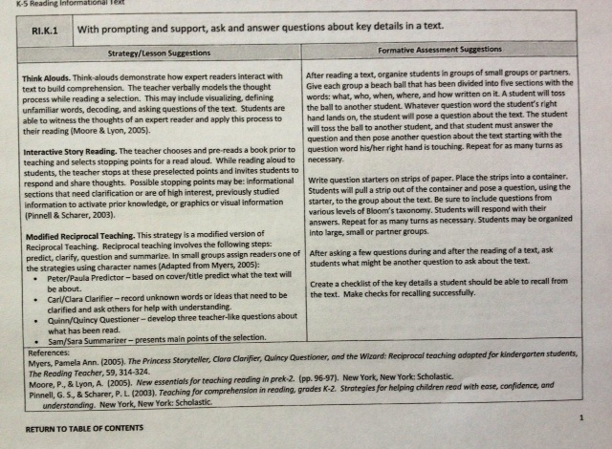
Target Strategies to Learn
Notes:
Each Atlas grade level unit has these strategies attached…

Slide 23
Orientation Week…
IV. ELA Department Meetings
Work collaboratively to create vertical and horizontal planning maps
Agree to mapped outcomes
Submit plans to Instructional Coordinators/Director ELA by October 15th
Monitor progress throughout the year

Slide 24
Creativity, Critical Thinking, and Communication
Notes:
Creativity, Critical Thinking, and Communication is what collaboration is all about.

Slide 25
Vertical and Horizontal Plans
Notes:
Schools create some version of this…

Slide 26
Orientation Week…
V. ELA Department Meetings
Review Writing Scope and Sequence by assessment
Review Atlas units by grade level
Revise and submit school scope and sequence to Director by September 30th.

Slide 27
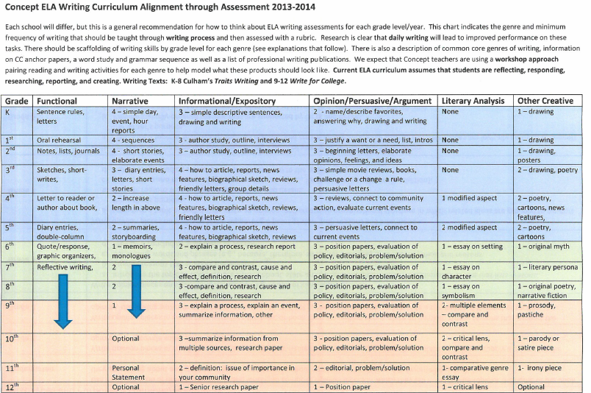
Sample Writing Alignment
Notes:
Schools create some version of this.

Slide 28
Other…
Two Course Descriptions not in Atlas
College & Career Composition
AP Language and AP Literature
Notes:
Take them to where this is posted on ELA website and other sources…

Slide 29
PD 2013-2014
Planning and Designed units (focus area 1)
Lesson strategies (focus area 2)
Assessment creation (focus area 3)

Slide 30
Things to become familiar with:
Article_Backward_Design explanation by Wiggins and McTighe
See also work of ELA Curriculum Team
Targeted RI strategies with explanations from “Realizing Illinois” (CCSS – RI Strategies, K-5, CCSS – RI Strategies, 6-8, CCSS RI Strategies, 9-12)
Writing in all class – Concept Writing Curriculum Alignment through Assessment 2013
Book Information Concept ELA Book Explanations-Teachers
PARCC Overview literacy documents, April 2013
PARCC Selecting Texts quality criteria, April 2013

Slide 31
Concept ELA Design Team
Michael Bidwell – HSA Cincinnati
Jennifer Brown – HSA Springfield
Sarah Gordon-Church – Quest Peoria
Jessica Lorimor – HSA Loraine
Caroline Clarke – HSA Columbus
Erica Fawley – HSA Dayton
Daniel Harting – CMSA Indianapolis
Ashley Kent – HSA Dayton
Abbey Pinkerton – CMSA Chicago
Megan Press – CMSA Chicago
Katherine Sagasser – HSA Toledo

Slide 32
Concept ELA Programs
Spelling Bee – December 7, 2013
Writing Contest – February 4, 2014
Speech and Spoken Word Competition – April 12, 2014

Slide 33
Handy Common Core Booklet

Slide 34
ELA Website

Slide 35
Creativity, Critical Thinking, and Communication is

