Slide 1
Concept English
Orientation
2015/2016

Slide 2
Session 1a
Planning Reading

Slide 3
It is very possible that a teacher can be good doing what she/he is comfortable with or by simply following the resource explicitly, but she/he might be great by constantly changing how she/he thinks about teaching and learning.

Slide 4
Warm Up
Read Write Think Planning Guide
First Reading
1. As you read think about what is going on and how you know.
2. Create 2 possible close reading questions that will help students.

Slide 5
Warm Up
Second Reading
1. Groups read only paragraphs indicated in margins
2. As you Read Aloud ask yourself how the author’s choices help you understand or appreciate something you didn’t notice the first time.
3. Brainstorm 3 possible close reading questions you could use with students.

Slide 6
Warm Up
Third Reading
Build on Poster Paper…

Slide 7
Jigsaw the Text
Rotating Cooperative Groups
Part to Whole Relationships

Slide 8
Session 1b
Unit Layout and Requirements, Lesson Plans, and SIS

Slide 9
Requirements 2015-2016

Slide 10
Session 2
Model 11th Grade Collection/Unit 2
Building a Democracy

Slide 11
Non-Linear Process

Slide 12
Assessment First Activity
Annotate as you read:
Focus on the content and the product
Identify how each author (C)
Balance between individual rights and union (C)
Information, topic statement (P)
Transitions (P)
Precise language (P)

Slide 13
Anchor Texts

Slide 14
Adding to the Mix
What OTHER READINGS DO I WANT?

Slide 16
One Text Activity, Declaration of Independence
Who
What
Where
When
Why
A Political Argument

Slide 17
Strategy – Micro Level

Slide 18
How

Slide 19
Jigsaw in Action
https://www.teachingchannel.org/videos/ethos-pathos-logos

Slide 21
Essential Question…

Slide 22
Strategy – Macro Level
What is your system for knowing students can compare the works and complete the analysis necessary for the PBA?
What would happen if you connected column 1 to the essential question?

Slide 23
Session 3 & 4
Interactive Workshop, Grade Level Teams

Slide 24
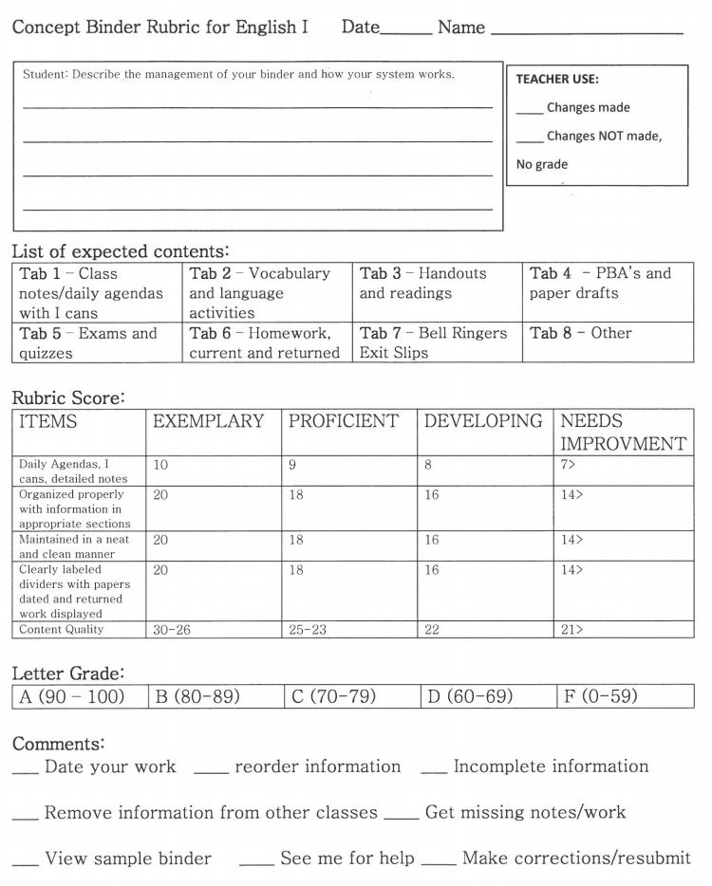
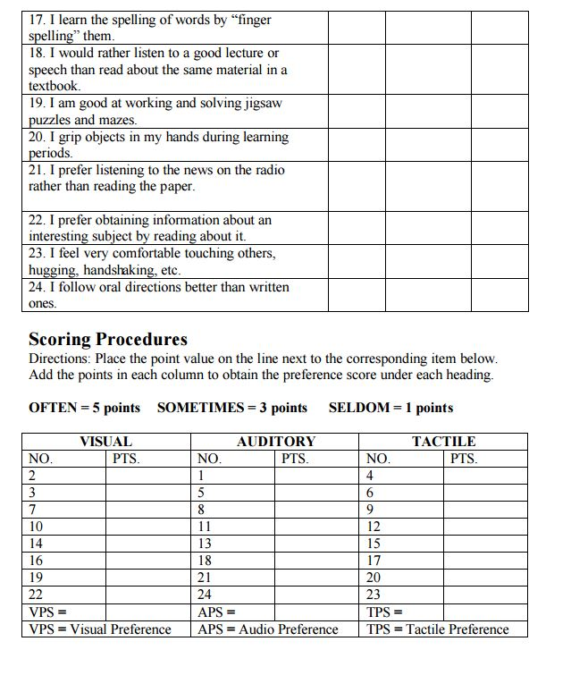
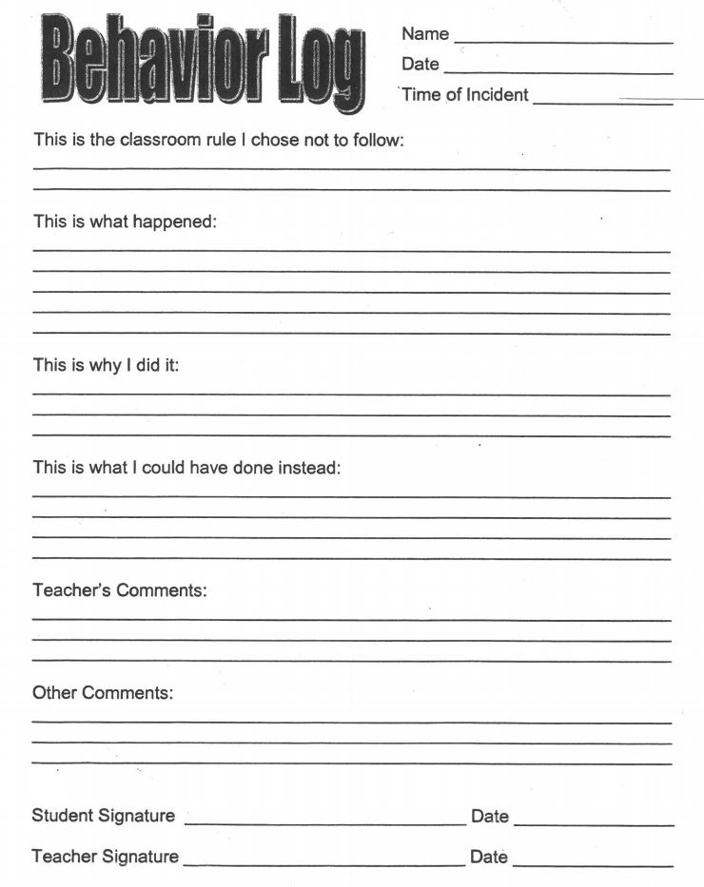
Grade Level Teams
Rituals and Routines
Two week mini-unit is your opportunity to build relationships with students and set up your systems. I would like to recommend 3 things that have worked well for me:

Slide 25
And always a favorite strategy

Slide 26
I Do, You Do, We Do
Planning for Instruction

Slide 27
Grade Level Teams PBA First…

Slide 28
I DO!
Anchor Text Public Document "The Declaration of Independence" - analyze features of a foundational U.S. document A close reading, text dependent approach to reading is indicated in the margins of the Teacher's Manual. Additional texts focus on more close reading and performance tasks (see the Close Reader and Common Core Assessment books) that add to or support the anchor text. See Teacher's Manual for further explanations. Analyze Structure: Style and Content, Page 117 Analyze Foundational Documents: Theme and Rhetorical Features, Page 117 Analyzing Text Questions, Page 118 Performance Task, Speaking Activity: Evaluation, Page 118
Vocabulary Strategy - Domain Specific Words, Page 119 Language Strategy - Parallel Structure, Page 120
What skills and standards are you being asked to teach in these Anchor Texts?
Next page review the standards and the essential question and unit overview?

Slide 29
Standards and Overview

Slide 30
Themes, Vocabulary, and…

Slide 32
You Do! Unit 1, Collection 1
Packet Collection/Unit 1 – you have already looked PBA
Read Anchor Texts – note skills
Review standards and unit essential questions/overview
Consider the academic vocabulary
Infer what language skills will be necessary for students to learn
Brainstorm additional ideas and connect themes

Slide 33
Work in Teams
Info needed

Slide 34
Completed Model

Slide 35
Inquiry Based

Slide 36
A great resource for understanding models like Inquiry based learning is:
http://www.thirteen.org/edonline/concept2class/inquiry/

Slide 37
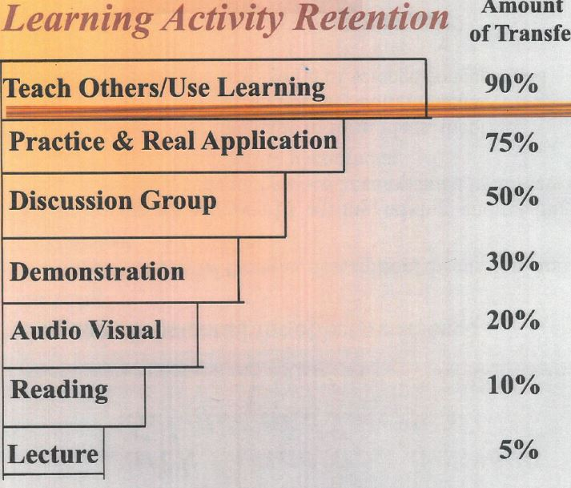
Instruction

Slide 38
Instruction

Slide 39
Final Thought
Plan for the surprises that become the teachable moments!

