Slide 1
Concept English Meeting
Regional Professional Development
Fall 2014

Slide 2
Agenda
Teacher Leadership – Strategy from Realizing Illinois
Concept English Updates
  Procedural Information
  Special Events, Spelling Bee
  PARCC documents/checklist
Marzano Strategy for Disciplinary Literacy
Conclusions

Slide 3
Teacher Leadership
Ms. McKinley

Slide 4
Taking Risks
Build your teaching repertoire
  Adding new strategies that address the rigor of the standards and the instructional shifts

Slide 5
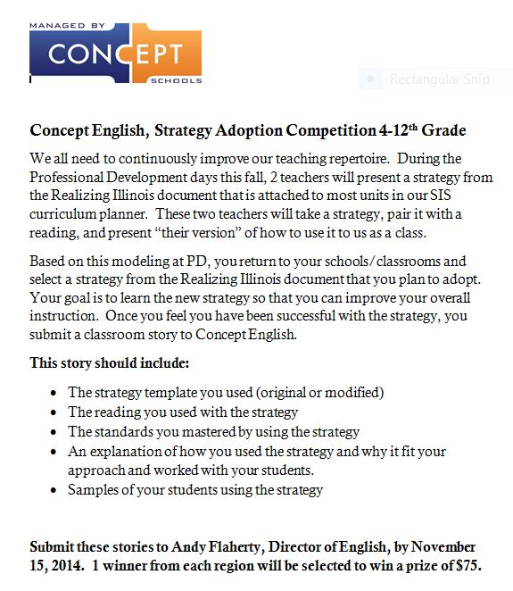

Slide 6
Concept English Updates
Procedural Information

Slide 7
Update Information
11/33 Department Meeting Notes
7/33 Scope and Sequence Documents
2 Coaches Webinars
7 School Webinars on new resources
4 School Webinars scheduled
117 on-going email requests for help
37 phone calls
9 on-going weekend telephone calls
PD – ongoing small workshop sessions

Slide 8
Concept English Updates
Spelling Bee 2014

Slide 9

One of Two Versions

Slide 10
Schedule/Due Dates
Posters/Requirements/Ideas 9/12
Student Registration 11/19
Event 12/6
  http://english.conceptschools.org/concept-spelling-bee/

Slide 11
Concept English Updates
PARCC Resources

Slide 12
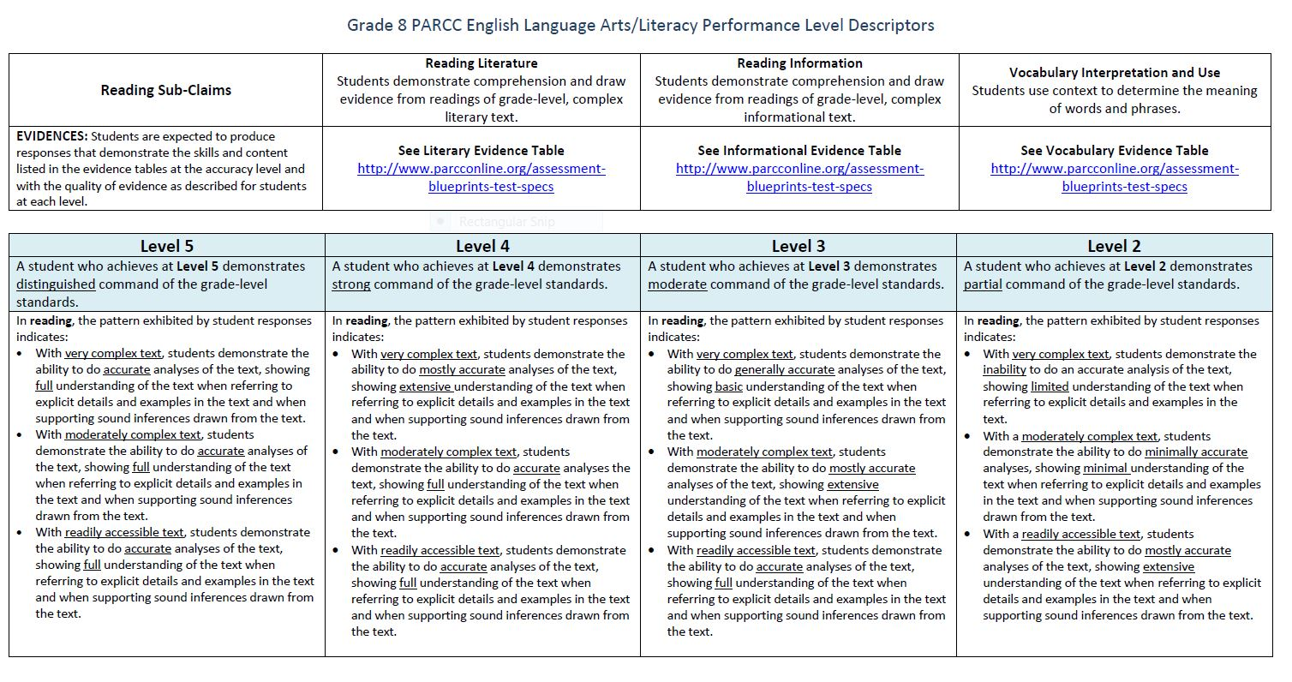
Performance Descriptors

Slide 13
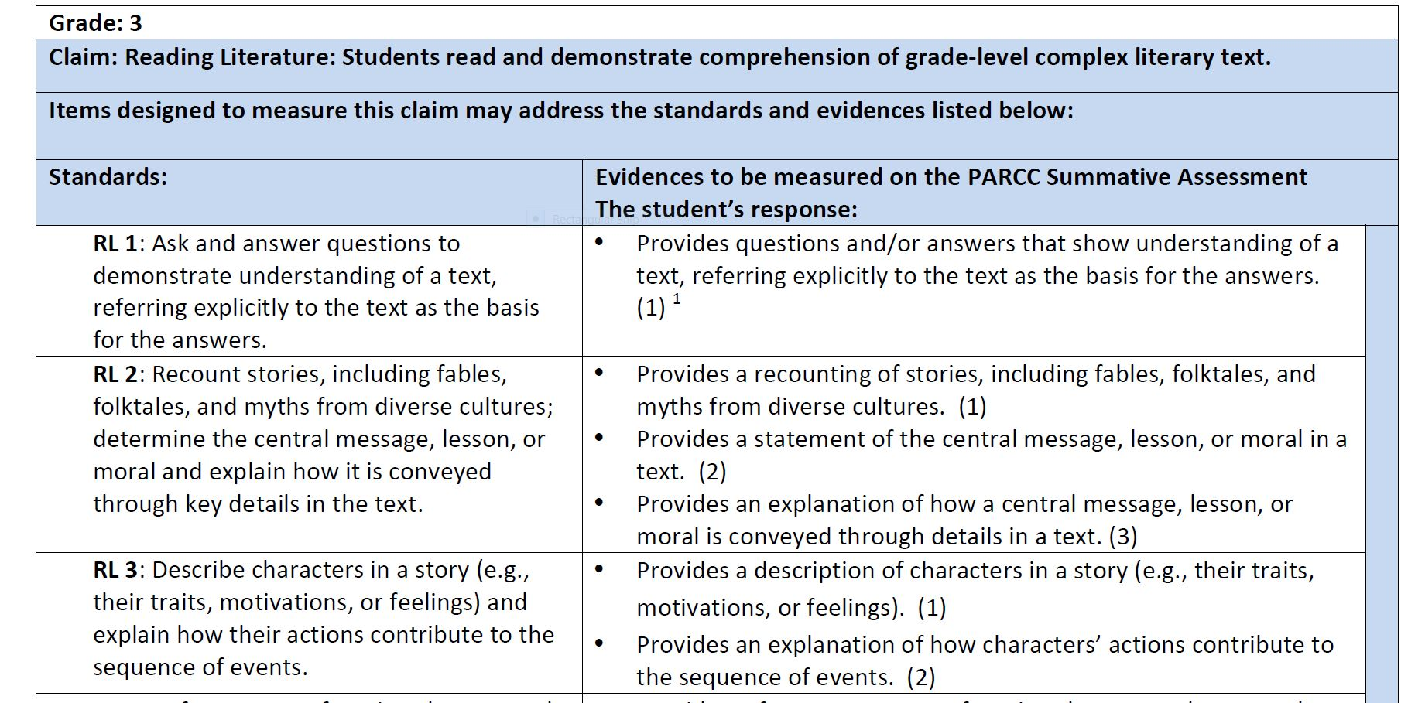
Evidence Tables

Slide 14
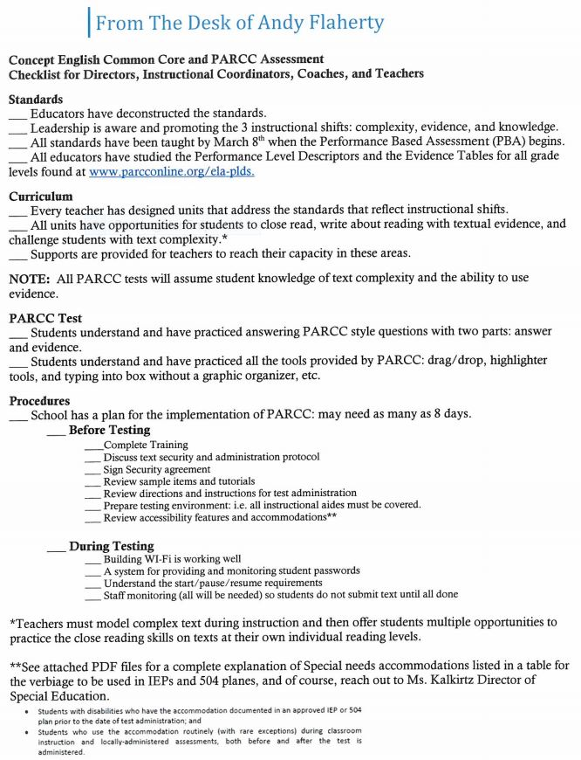
PARCC Checklist

Slide 15
Concept English
Research Based Strategies
Marzano’s Inside Outside Circle
Clare Brooks and Andy Flaherty

Slide 16
Activity
1. List 3 non-management issues that affect your classroom learning.
2. Break off into grade level groups
3. Discuss your lists and create one list with top 3 issues
4. Prepare 1 solution for one or all of the issues

Slide 17
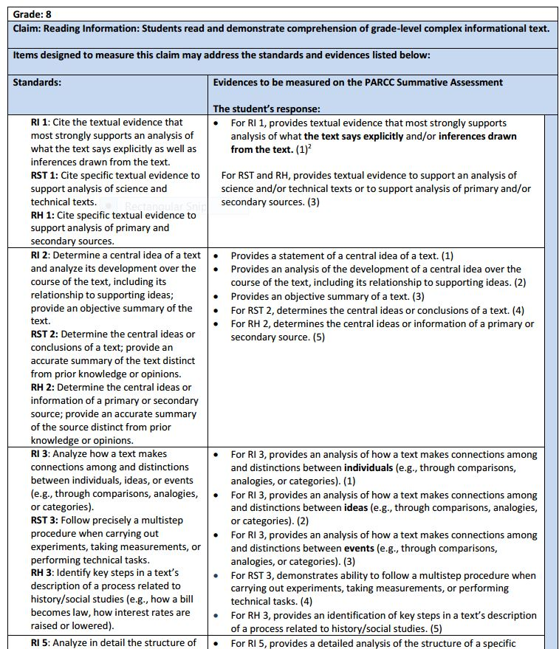
Activity
Read RI1
Create sentence starts for your students to be able to take the action listed under student responses (Constructed Response)
Performance Descriptors for PARCC
Connect with I can statements

Slide 18
Activity
From “The Astronauts Wives Club”
ReadWorks.org
A new book called The Astronaut Wives Club by Lily Koppel, has changed that. Koppel’s bestseller tells the stories of the strong women behind the men who pioneered space travel. The book begins in the late 1950s, when a man’s family is seen as a reflection of his work life: a good home with a pretty wife and adorable children translated into a good career. An important part of an astronaut's wife's job was to maintain the perfect image of domestic happiness. Astronaut wives were pressured by NASA, their husbands, and their own sense of duty to display an outward image of family perfection. They had to smile their way through dealing with the fears for their spouses' safety and the challenges of maintaining a home and children with almost no help. It was a difficult path, but also served as the basis for the strong friendships that grew between the women. The astronauts’ wives were in it together.
The Houston suburbs where the wives made a home for their heroic husbands were called the “Spaceburbs,” or sometimes “Togethersville.” Along with triumph, the town was also the scene of tragedy. Seven of the first 30 astronaut wives lost their husbands during the Mercury, Gemini, and Apollo missions. After astronaut Ed White perished in a capsule blaze, his wife Pat fell into deep depression. In an interview with the author, another astronaut wife described Mrs. White: “She just worked at being Ed's wife. She was wonderful at it. That's all.”
Read and annotate the excerpt provided.
Participate in the Marzano activity.

Slide 19
Question #1 – Part A
With your partners answer…
How does the passage describe the wives of America’s first astronauts?
A. Examples of mental and physical excellence
B. Perfect American wives and homemakers
C. Strong, courageous, and independent
D. Overwhelmed by responsibility and pressure

Slide 20
Question #1 – Part B
With your new partner highlight evidence from the text that supports the answer you chose.

Slide 21
Question #2
What is this passage mostly about?
A. Movies about famous space missions, such as Apollo 13
B. The problems and difficulties faced by American astronauts
C. The strong wives who supported the first astronauts
D. The Houston ”spaceburbs” where astronauts families lived.

Slide 22
Summarize
Write a 2 sentence summary about the passage you have just read.

Slide 23
Brainstorm

Slide 24
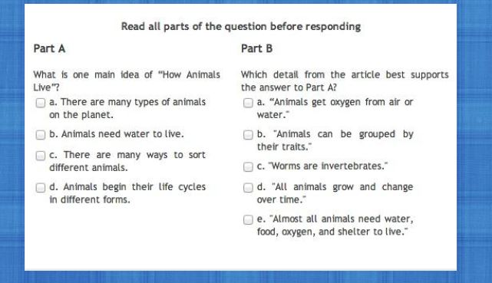
Sample Questions 3-8th Grade

Slide 25
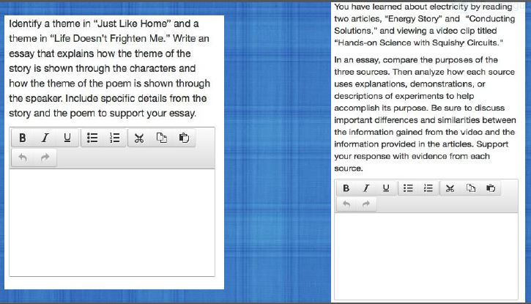
PARCC WRITING

Slide 26
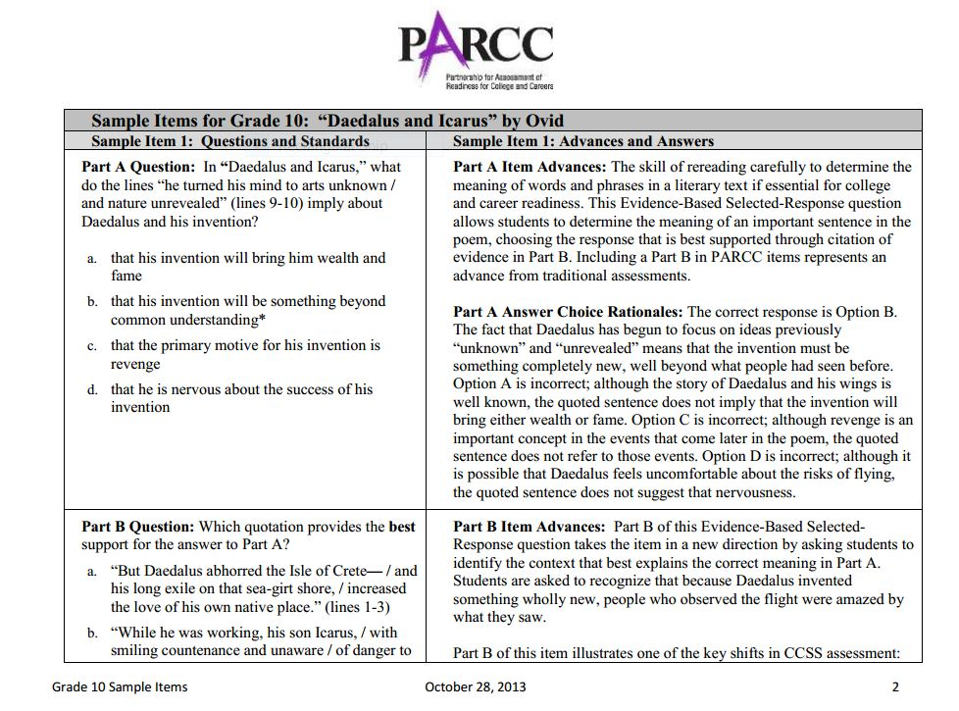
Sample High School Question

Slide 27
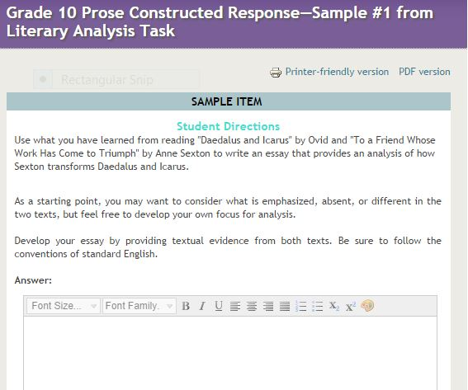
Sample High School Question

Slide 28
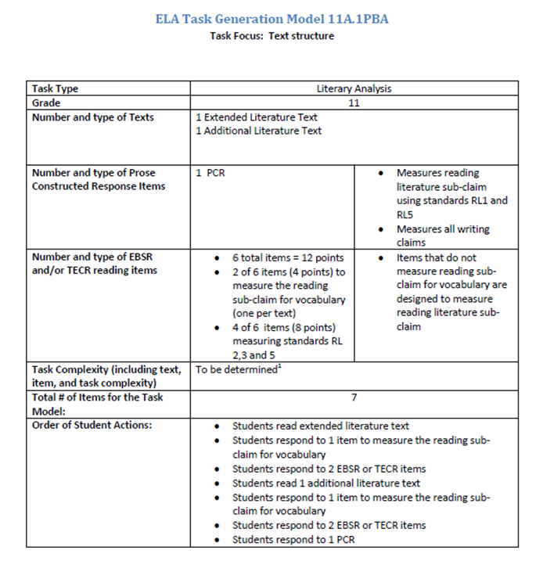
PBA High School

Slide 29
3 Key Shifts* Today
1. Regular practice with complex text and its academic language. COMPLEXITY
2. Reading, writing, and speaking grounded in evidence from the text both literary and informational. EVIDENCE
3. Building knowledge through content-rich nonfiction. KNOWLEDGE
*From achievethecore.org and PARCC

Slide 30
Conclusions

Slide 31
Traditional Design
Traditional design is like...
Traditional design follows…
…setting out on a trip and not knowing where you are going (what skills) and not knowing how you will know when you get there
…textbooks
…reading series
...favorite themes
Notes:
On this slide, the presenter can talk about how lesson plans are traditionally designed.

Slide 32
What Is Backward Design?
It’s thinking about assessment before deciding how you teach, planning instruction, what resources you will use and finally and most importantly….
“How will the student prove he/she has learned the target?”
(Wiggins and McTighe )

Slide 33
UbD -3 Steps
1. Results
2. Evidence
3. Learning Experiences

Slide 34
Instructional Delivery
Teach and model reading of difficult text
Have student practice the process and skills with readings at their own level
Model the writing process
Practice without graphic organizers

Slide 35
ReadWorks
http://www.readworks.org/passages/astronaut-wives-club
CCSS.ELA-Literacy.RI.8.5 | Analyze in detail the structure of a specific paragraph in a text, including the role of particular sentences in developing and refining a key concept.

Slide 36
3 Questions for Students
1. Why do you think you need to learn today’s concept or skill? How will it help you now and when you are an adult?
2. How does today’s concept or skill relate to what you already know or have recently learned?
3. How does today’s concept or skill connect with a bigger picture or concept?

