Slide 1
Critical Thinking
Andy Flaherty
Concept English
November 2013
aflaherty@conceptschools.org

Slide 2
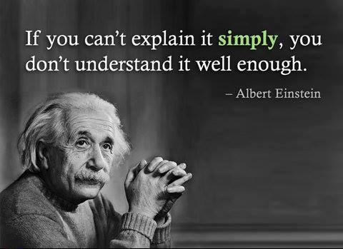
KIPP VIDEO

Slide 3
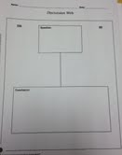
During Viewing
Pose a Question
Students read or watch and:
List agreements – yes
List disagreements – no
Draw conclusions
“Because”

Slide 4
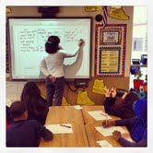
Why Web?
Student think better when they can see
Students then have a “shared” list of ideas
Students build community around ideas

Slide 5
Ten Tips for Teaching Critical Thinking
1. Use questions
2. Unpack prompts
3. Tools to enter conversations
4. Model expectations
5. Encourage constructive controversy
6. Engage through content
7. Use Socratic discussions
8. Assess reasoning differently
9. Use peer evaluations
10. Step back
Notes:
The teacher at KIPP trains everyone for critical thinking by having them write an argument – relevance, accuracy, clarity and secificity.

Slide 6
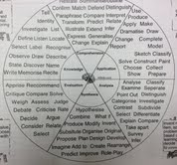
Bloom’s Taxonomy
Provide students with question frames

Slide 7
What did George Washington do as President? To what extent was George Washington successful as President?
Questions:
Frame assignments
Not right or wrong but arguable
Require synthesis of pieces

Slide 8
Deconstructing Prompts
http://www.slideshare.net/pwald/deconstructing-an-essay?utm_source=slideshow03&utm_medium=ssemail&utm_campaign=share_slideshow
Builds meta-cognition, exposes teaching needs, and promotes deeper learning

