Slide 1
Regroup and Regain CCSS Understanding for English
Andy Flaherty
aflaherty@conceptschools.org

Slide 2
Everything we can to
Remove the Obstacles

Slide 3
Key Dates
Goals 2000
2002
2008
2009
2014/2015
Notes:
Benchmarks for Success 2002 NCLB, 2008 Achieve and ACT, 2009 CCSS, 2014/15 PARCC Tests

Slide 4
Why ENGLISH MATTERS SO MUCH
Common Core and the new Assessments mean:
Students can read, write, and speak about a subject
Students can use language to communicate ideas

Slide 5
Final Thoughts
The Common Core does NOT:
Tell teachers HOW to teach
Tell all that can or should be taught
The Common Core DOES:
Expect more rigor in teaching
School leaders to know the standards and support their mastery
Notes:
From presentation 2 years ago…

Slide 6
A winning Approach
A system in place that allows for professional dialogues for change so that all parties know and understand.
Simple
Flexible
Reliable
Economical
Acceptable

Slide 7
College Readiness & Common Core
Common Core standards are anchored in the College and Career Readiness standards.

Slide 8
English Language Arts
Common Core Standards
Reading Strand
Writing Strand
Speaking and Listening Strand
Language Strand
Key Ideas and Details
Craft and Structure
Integration of Knowledge
and Ideas
Range of Reading and Level of Text Complexity
Text Types and Purposes
Production and Distribution
of Writing
Research to Build Knowledge
Range of Writing
Comprehension and Collaboration
Presentation of Knowledge
and Ideas
Conventions of
Standard English
Knowledge of Language
Vocabulary Acquisition and Use
Notes:
Incomplete – your foundational skills for lower grades and your disciplinary literacy standards for science, history, and technical subjects….

Slide 9
Part to Whole Connections
Connected & Integrated
English is Literacy
Notes:
Integrated = Balanced

Slide 10
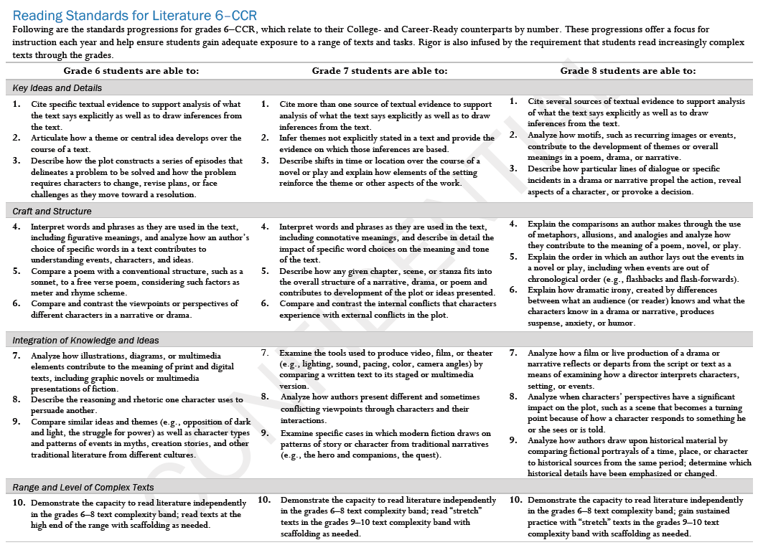

Slide 11
Anchor Standards and…
Literacy standards for History/Social Studies, Science and other Technical Subjects (Grades 6-12)
Disciplinary Literacy
Notes:
Social studies is pushing this…

Slide 12
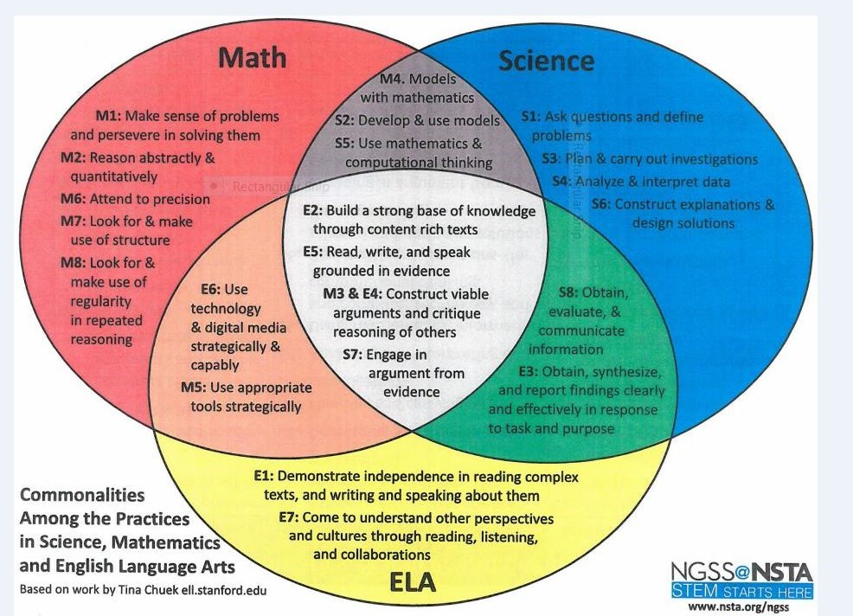
Organizations Recognize

Slide 13
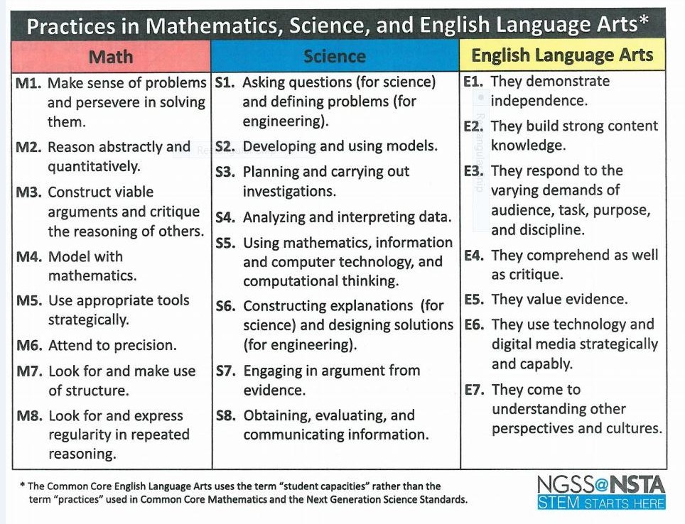
Organizations Recognize

Slide 14
Unpack a Standard
Read the standard you have been handed
Identify key words, patterns, ideas
Restate it in your own words
Each Umbrella standard has with many mini-standards inferred underneath it.
Delaware Literacy Organizers

Slide 15
Key Words in the Standards
ELA K-5
ELA 6-12
Understanding 33
Read 28
Write 22
Demonstrate 19
Clarify 18
Develop 18
Produce 17
Relationships 16
Describe 14
Compare/Contrast 13
Analyze 73
Determine 50
Develop 41
Research 33
Clarify 32
Write 31
Relationships 30
Demonstrate 28
Understanding 27
Create 26

Slide 16
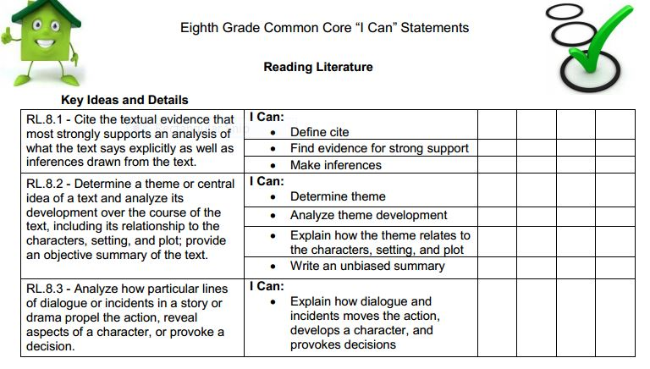
Standards and I can statements

Slide 17

3 Key Shifts* Today
1. Regular practice with complex text and its academic language. COMPLEXITY
2. Reading, writing, and speaking grounded in evidence from the text both literary and informational. EVIDENCE
3. Building knowledge through content-rich nonfiction. KNOWLEDGE
*From achievethecore.org and PARCC

Slide 18
Standard 1 and 10
Two English standards are in play on every PARCC test question:
  Standard 1 – use of Evidence
  Standard 10 – complex text

Slide 19
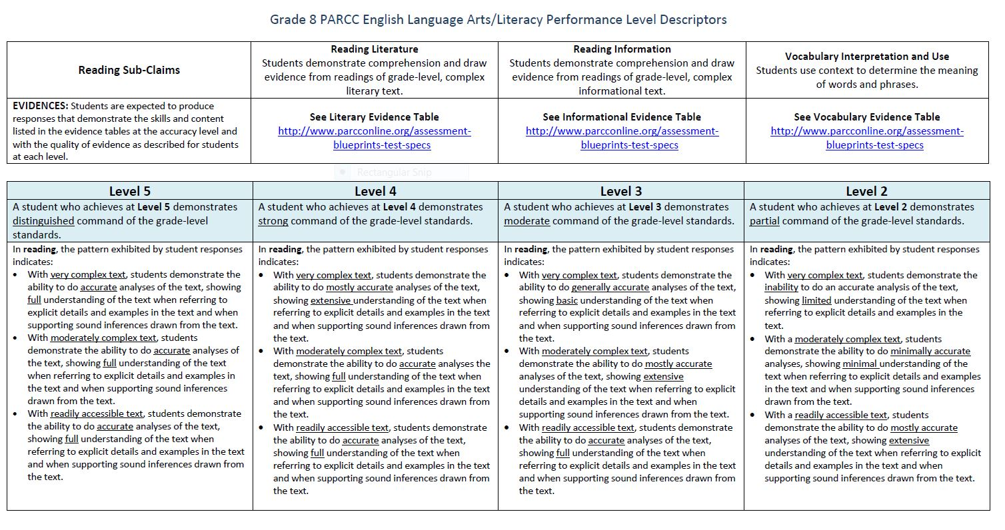
Performance Level DeScriptors

Slide 20
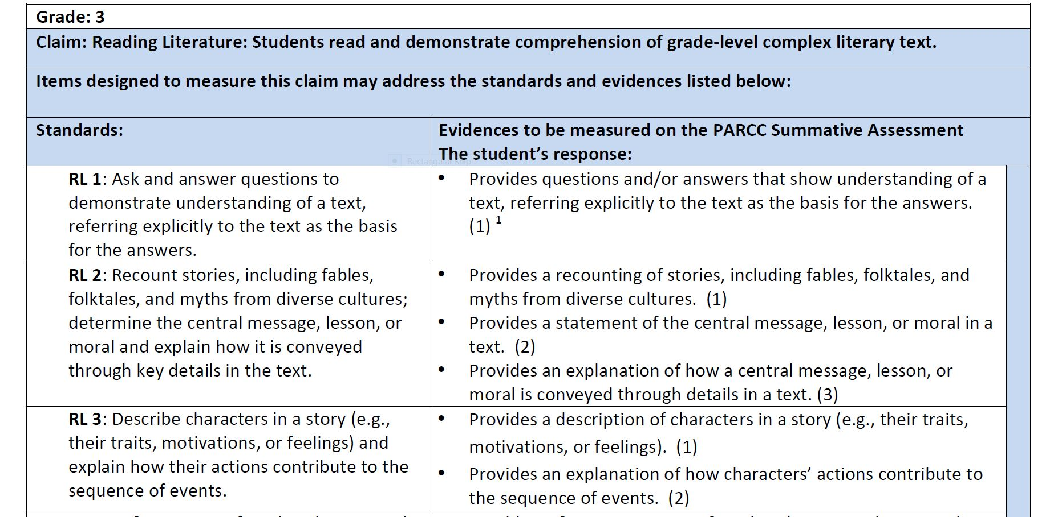
Evidence Tables

Slide 21
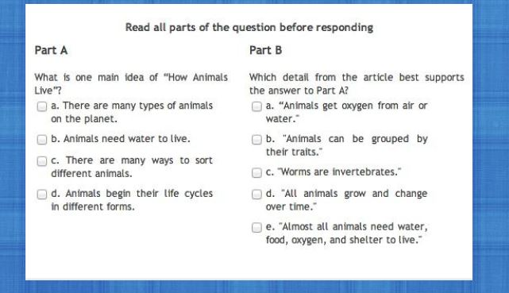
PARCC Reading 3-8th Grade

Slide 22
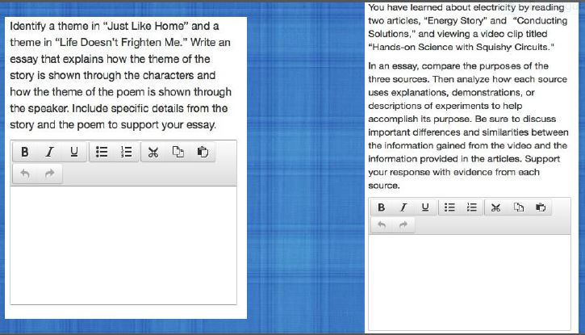
PARCC WRITING 3-8th Grade
Notes:
Races

Slide 23
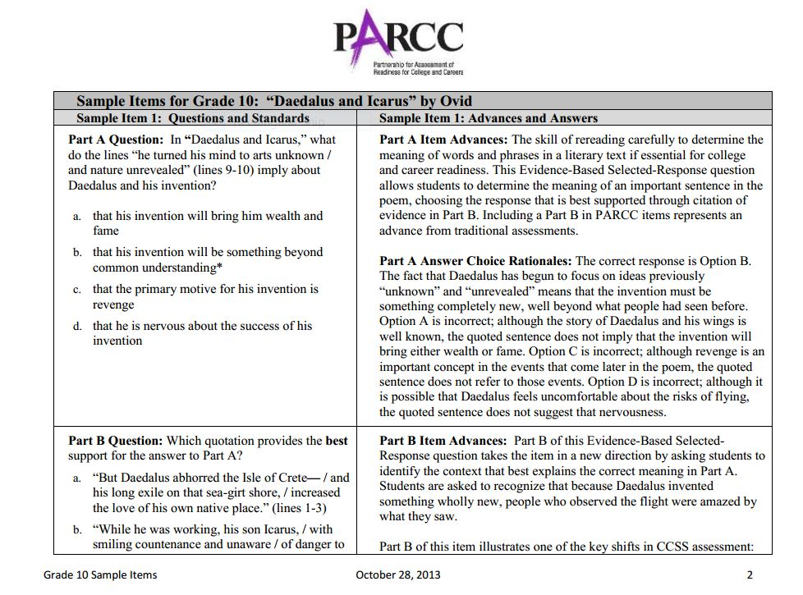
PARCC High School

Slide 24
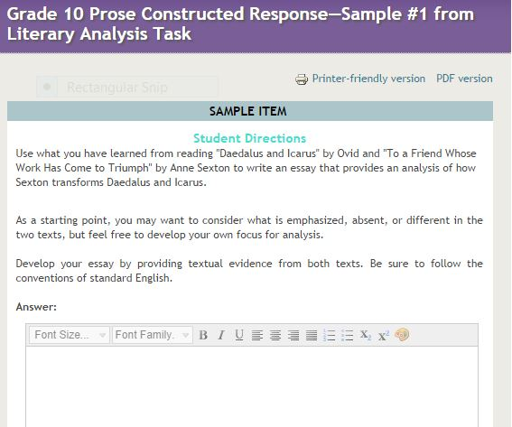
PARCC High School

Slide 25
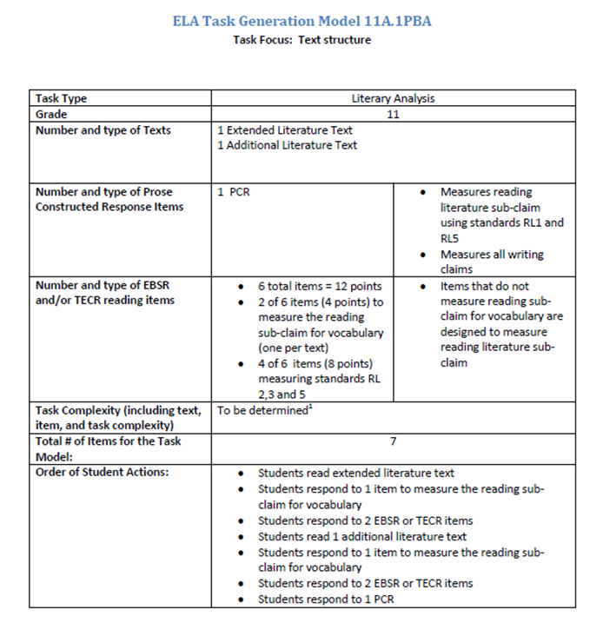
PARCC PBA

Slide 26
Guidelines from PARCC
Minimum/Maximum Passage Length for Literary and Informational Texts
3 – 5 grade: 200 – 800 words
6 – 8 grade: 400 – 1,000 words
9 – 11 grade: 500 – 1,500 words

Slide 27
Recommended Balance
Distribution of Literary and Informational Passages by Grade in the 2009 NAEP Reading Framework
Grade Literary Information
4 50% 50%
8 45% 55%
12 30% 70%
(2008). Reading framework for the 2009 National Assessment of Educational Progress. Washington, DC: U.S. Government Printing Office.

Slide 28
What does Common Core mean for administrators?
Know Standards and Alignment documents
Support Concept English expectations
Recognize literacy effects all content areas
Expect teachers to change
Provide time to work
Support inquiry and mistakes
Have a school-wide plan
Notes:
Social Studies and Science teachers should be able to say how they are helping

Slide 29
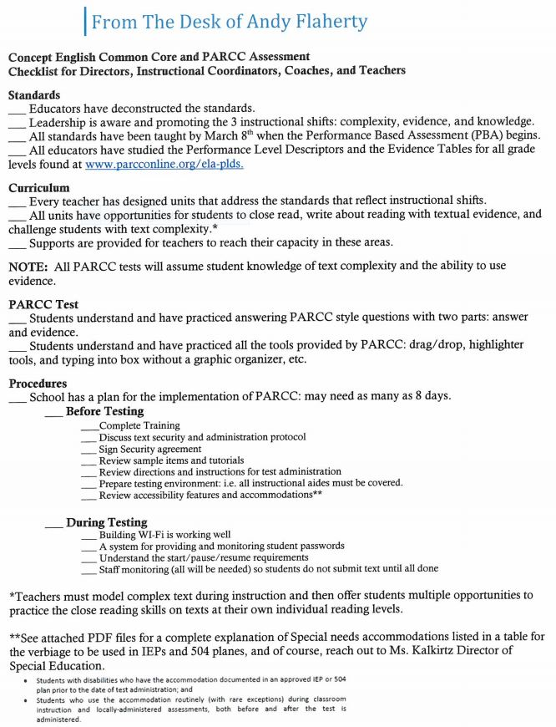
September/October Checklist

Slide 30
Reflection
Promoting Change, Supporting Change, and Implementing Change is our Concept goal.
Notes:
That is what I have done today

Slide 31
Update Information
7/33 Department Meeting Notes
4/33 Scope and Sequence Documents
2 Coaches Webinars
3 School Webinars on new resources
4 School Webinars scheduled
97 email requests for help
37 phone calls
9 on-going telephone calls/emails for help
8 Workshops with small groups of teachers

Slide 32
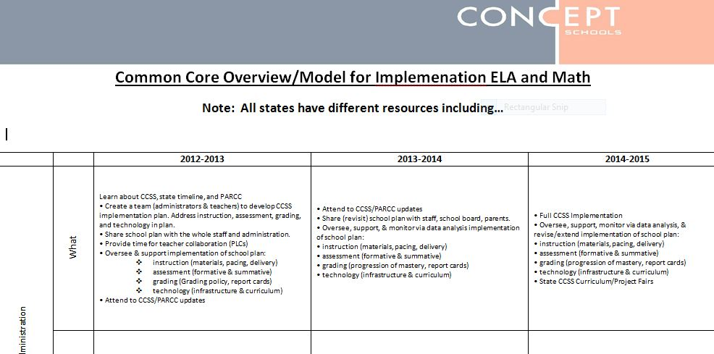

Slide 33
Traditional Design
Traditional design is like...
Traditional design follows…
…setting out on a trip and not knowing where you are going (what skills) and not knowing how you will know when you get there
…textbooks
…reading series
...favorite themes
Notes:
On this slide, the presenter can talk about how lesson plans are traditionally designed.

Slide 34
What Is BACKWARD DESIGN?
It’s thinking about assessment before deciding how you teach, planning instruction, what resources you will use and finally and most importantly….
“How will the student prove he/she has learned the target?”
(Wiggins and McTighe )

Slide 35
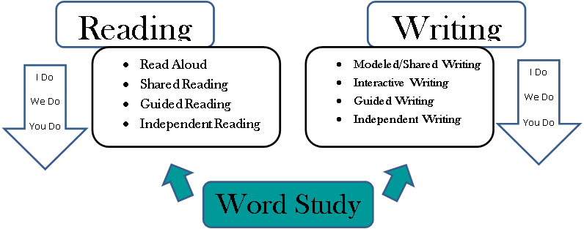
Instructional Delivery – Balanced Literacy
Writing
Notes:
Rationale for balanced literacy framework
Students represent a range of multiple reading levels, with varying literacy needs.
It is important to provide students with the right balance of language, word study, fluency, reading accuracy, comprehension, and writing instruction each day.
Margaret Mooney says balanced literacy can be achieved by (1) reading to children daily, (2) reading with children (shared reading and guided reading), and (3) reading by children (independent reading such as in literature circles).
Reading researcher, Richard Allington, suggests that when struggling readers are provided with instruction at the point of need using instructional & independent leveled texts throughout the school day, an overwhelming amount of data indicates a greater opportunity of closing the achievement gap.

Slide 36
Unit/Lesson Requirements:
Assessment/Assignment Minimum Expectations
  3 structured discussions
  2 oral presentations with rubric
  5 short writing assignments with rubrics that target a specific skill
  1 extended writing assignment with rubric
  1 21st century skills
  3 non-traditional text assignments
  On-going Readers and Writers Workshop
  On-going progress monitoring/running records of reading
  Prepare students for state tests, EOC, and PARCC or Smarter Balanced
  EVIDENCE OF A BALANCE BETWEEN FICTION/NON-FICTION TEXTS! Novels should be taught within the context of existing Master Curriculum, not in isolation and paired with strong non-fiction readings.
  * K-3 grade teachers make adjustments based on Ms. Sajovec’s direction.

Slide 37
Successful Schools
Effectively communicate the importance of the literacy and math tools
Coordinate efforts to align with and support the use of standards and strategies.
Provide a range of resources
including time for ongoing meetings
Provide PD that helps all educators gain a deeper understanding of standards and assessment
*Research from schools that piloted tests.

Slide 38
Six Facets of Understanding
Explanation | Sophisticated explanation and theories
Interpretation | Narratives, translations, metaphors, etc. that provide meaning
Application | Ability to effectively apply knowledge in a variety of contexts
Perspective | Critical and insightful points of view. Recognize the significance of ideas
Empathy | Ability to see things from other points of view
Self-Knowledge | Deeply aware of own boundaries and ability to recognize the limits of others
Wiggins, G. and McTighe, J. (1998). Understanding by Design. Alexandria, VA: Association for Supervision and Curriculum Development

Slide 39
G.R.A.S.P.S
Performance Task Scenario
G =
R =
A =
S =
P =
S =
Goal
Role
Audience
Situation
Product/Performance and Purpose
Standards for Criteria and Success
Wiggins, G. and McTighe, J. (1998). Understanding by Design. Alexandria, VA: Association for Supervision and Curriculum Development

Slide 40
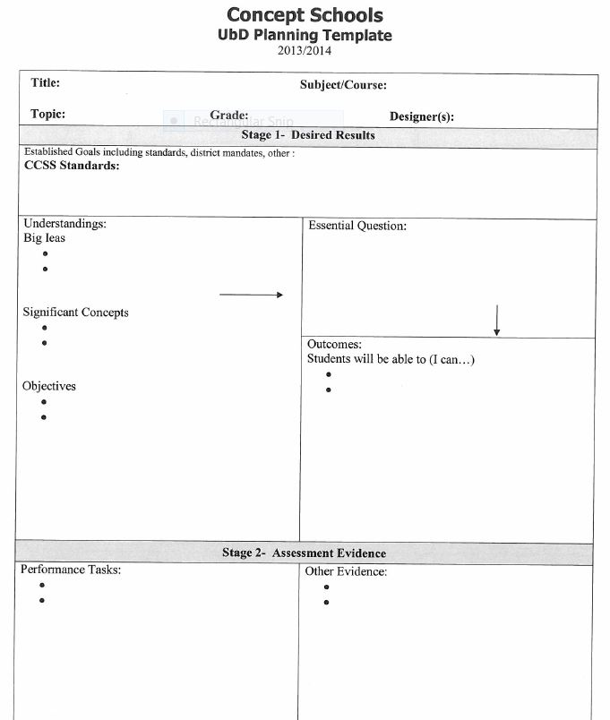

Slide 41
3 Questions for Students
1. Why do you think you need to learn today’s concept or skill? How will it help you now and when you are an adult?
2. How does today’s concept or skill relate to what you already know or have recently learned?
3. How does today’s concept or skill connect with a bigger picture or concept?

Slide 42
Resources
www.corestandards.org
www.commoncore.org
http://www.parcconline.org/assessment-blueprints-test-specs
“Bringing the Common Core to Life” - http://vimeo.com/channels/parccinstitute#25242442

