Slide 1
Designing Competency Based Training with Bloom’s Taxonomy
Michele B. Medved
mbmtraining@yahoo.com
http://mbmtraining.com
Learning in the News http://mbmtraining.wordpress.com/

Slide 2
The Big Performance Picture
Business Needs
Competencies
Learning Goals/Outcomes
What performance will meet business needs?
Which knowledge, skills and attitude will enable performance to meet business needs
Performance
What is is the challenge/opportunity?
Which objectives will ensure learners are competent to meet business needs?
Knowledge
Skills
Attitude

Slide 3
What is competency?
A combination of skills, knowledge and attitude that enables an individual to perform a task to the standards required for successful job performance.
Deals with "what is expected in the workplace."
Emphasis on performing an actual job and not gaining knowledge or skills for their own sake.

Slide 4
Key Learning Activity #1
Consider a specific business need.
Identify one performance task that can meet that need.
Identify the knowledge, skills, attitude (3-5 of each) to achieve competency in that task.
Share answers with a partner.
Examples of performance:
Giving a presentation
Conducting a subject matter expert interview
Writing a storyboard for e-learning

Slide 5
Bloom’s Domains of Learning/Competencies
Cognitive: Mental skills (Knowledge)
Affective: Growth in feelings (Attitude)
Psychomotor: Manual/physical skills (Skills)
Created in 1954

Slide 6
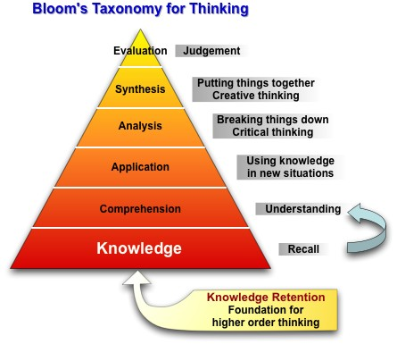
Cognitive Domain
Higher Ordered Skills (HOTS)
Lower Ordered Skills (LOTS)
Notes:
Taxonomy means classification of learning outcomes/objectives
learning at the higher levels is dependent on having attained prerequisite knowledge and skills at lower levels
The categories can be thought of as degrees of difficulties. Start with simple and become more complex. That is, the first one must be mastered before the next one can take place.

Slide 7
Why is Bloom’s Taxonomy Important?
All learning involves prior elements and stages
Before we can understand a concept, we have to remember it
Before we can apply the concept, we must understand it, etc.
Importance of analyzing prior knowledge
Focus on outcome, not tools
Knowledge based economy requires higher ordered thinking skills

Slide 8
HOT Skills for the Knowledge Economy
Lower ordered skill
collecting information
Higher ordered skills
categorizing and analyzing information
drawing conclusions from the information
brainstorming’ new ideas
problem solving
determining cause and effect evaluating options
planning and setting
monitoring progress
decision making
reflecting on one’s own progress

Slide 9
Knowledge Acquisition
Knowledge Deepening
Knowledge Creation
Remember
Understand
Apply
Analyze
Evaluate
Create

Slide 10
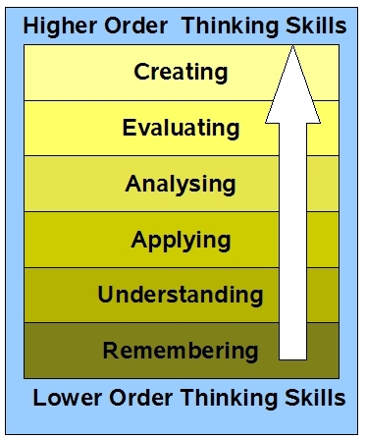
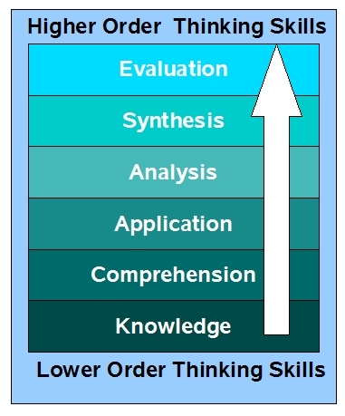
Bloom’s Revised Taxonomy
Published in 2001 by Anderson and Krathwohl
Notes:
Change from noun to verbs represents more active way of thinking
Creation is at top, represents highest level of learning

Slide 11
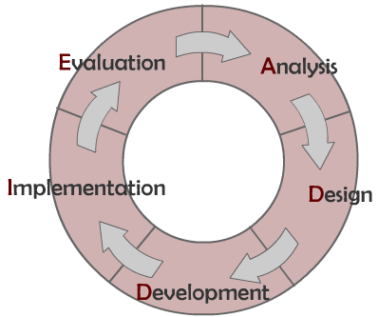
Bloom’s Taxonomy & ADDIE
Determine competencies to meet business needs
Assess prior knowledge
USE TAXONOMY
Write Objectives
Write Test Items

Slide 12
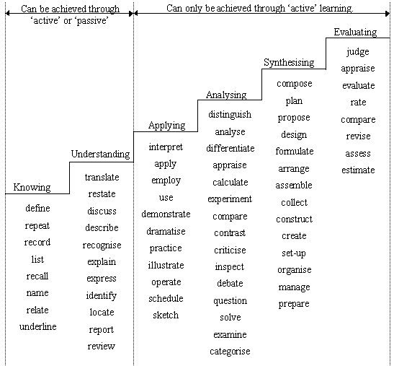
Facts
Concepts
Procedures
Principles
Process

Slide 13
Example of Writing Objectives
Knowledge: List six levels of taxonomy
Comprehension: Explain the importance of Bloom’s taxonomy
Application: Write an objective for each level of the taxonomy
Analysis: Compare and contrast original and revised version of the taxonomy
Evaluation: Judge the effectiveness of writing objectives using the taxonomy
Synthesis: Design a classification system for responding to a specific business need

Slide 14
Scenario #1: Procedure
Business Need: Company has merged with bigger organization. Managers need to follow new procedure for conducing performance reviews
Write objectives for each level of the taxonomy. Focus on higher ordered objectives.

Slide 15
Bloom’s Taxonomy & ADDIE
Performance needs assessment to determine competencies to meet business needs
Assess prior knowledge
Write Objectives
Write Test Items
Specify Instructional Strategy
Design Instructional Strategy

Slide 16
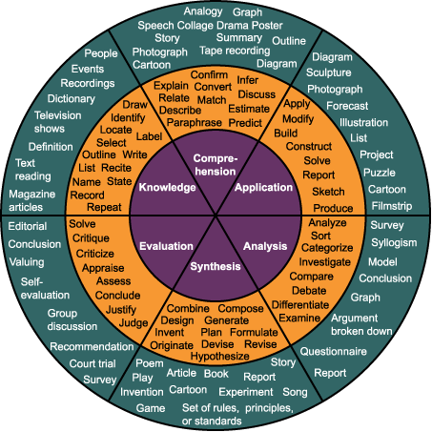
Instructional Strategies

Slide 17
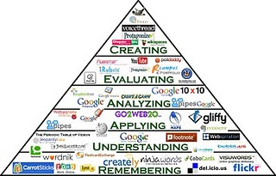
Instructional Strategies: Digital Tools
USE of technology determines whether it is a LOTS or HOTS application

Slide 18
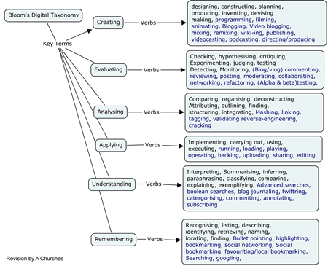

Slide 19
Example: Using Digital Tools
Remember, retrieve information
Retrieve a list of sites showing Bloom’s taxonomy list of verbs from a social bookmarking site. (delicious.com)
Understand
Explain the taxonomy using a mindmap.
Apply
Demonstrate knowledge of Bloom’s taxonomy by contributing to a shared wiki giving examples of objectives at each level.

Slide 20
Example: Using Digital Tools
Analyze
Organize best practices for Bloom’s Taxonomy by creating a survey using Google Forms
Evaluate
Critique the differences in the use of the taxonomy by responding to a threaded discussion
Create
Make a digital presentation on Bloom’s taxonomy to publish on the web

Slide 21
Scenario #2:Facts/Concepts
Business need: An organization has introduced a new product. Sales staff need to be able to sell the product as part of their solution-based approach.
List the learning outcomes and suggested instructional strategy at each level.

Slide 22
Key Learning Part #2
For your specific business need,related performance, and learning design
Reflect on how your scenario following
Considers prior knowledge
Includes higher ordered learning skills
Uses of verbs to reflect levels of thinking
Deploys Technology appropriate to each level
Share answers with partner

Slide 23
Summary
Define competency and apply definition to a personal task
Identify the six levels of cognitive behavior in learning
Use Bloom’s taxonomy, including each level, relevant verbs and instructional strategy to solve a business need

Slide 24
The Big Performance Picture
Business Needs
Competencies
Learning Goals/Outcomes
What performance will meet business needs?
Which knowledge, skills and attitude will enable performance to meet business needs
Performance
What is is the challenge/opportunity?
Which objectives will ensure learners are competent to meet business needs?
Knowledge
Skills
Attitude

Slide 25
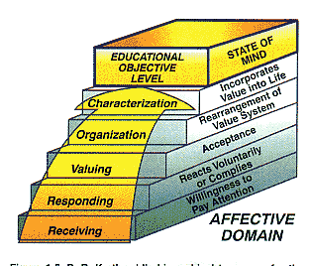
FYI: Affective Domain
Believe, Practice, Continue to, Carry out
Organize, Select, Judge, Decide,
Identify with
Attain, Assume, Support, Participate
Reply, Answer, Follow along,
Approve, Continue
Listen to, Perceive, Be alert,
Show tolerance of, Obey
Notes:
Competency is the ability of an individual to perform a job properly.
scholars see "competence" as a combination of knowledge, skills and behavior used to improve performance; or as the state or quality of being adequately or well qualified, having the ability to perform a specific role
Response to a business need

