Slide 1
Balanced Literacy and UBD

Slide 2
Balanced Literacy and Common Core State Standards
A “decision making approach through which the teacher makes thoughtful choices each day about the best way to help each child become a better reader and writer” (Spiegel, 1998).
Notes:
Balance of Whole Language and Phonics?

Slide 3
Objectives
Distinguish between (1) meaning, structure, and visual cues used during reading and between (2) top-down and bottom-up models of reading
Analyze the levels of support within the 3 components of a balanced literacy framework and its connection with common core state standards
Understand why text complexity matters and identify what makes text complex
Identify the components of the PARCC Literacy Content Framework and recognize how to plan instruction using balanced literacy elements
Notes:
Roadmap: if we know where we are going (assessment), and what has to get done/ what we need to have to get there (knowledge, skills), then we better know HOW to get students there

Slide 4
Reading: Meaning, Structure, Visual Cues
15 minutes
Jabberwocky by Lewis Carroll
Bottom-up and top-down models of reading
Common core emphasis on meaning and application of skills

Slide 5
Balanced Literacy Framework
25 minutes
Reading Workshop
Writing Workshop
Word Study

Slide 6
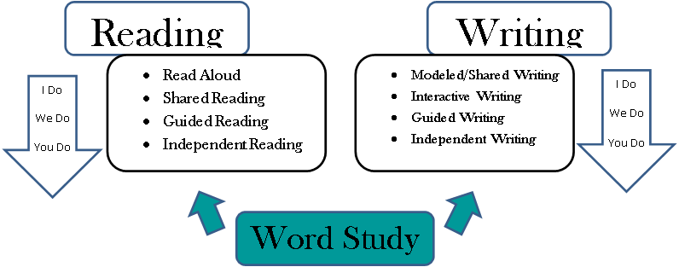
Reading
Writing
I Do
We Do
You Do
I Do
We Do
You Do
Notes:
Rationale for balanced literacy framework
Students represent a range of multiple reading levels, with varying literacy needs.
It is important to provide students with the right balance of language, word study, fluency, reading accuracy, comprehension, and writing instruction each day.
Margaret Mooney says balanced literacy can be achieved by (1) reading to children daily, (2) reading with children (shared reading and guided reading), and (3) reading by children (independent reading such as in literature circles).
Reading researcher, Richard Allington, suggests that when struggling readers are provided with instruction at the point of need using instructional & independent leveled texts throughout the school day, an overwhelming amount of data indicates a greater opportunity of closing the achievement gap.

Slide 7
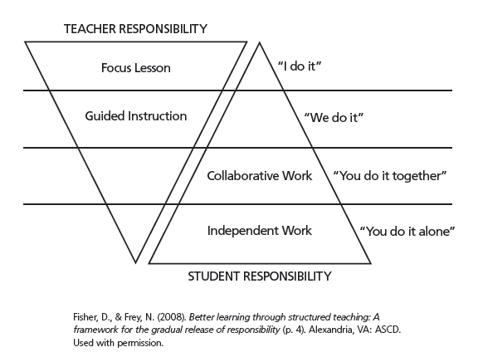
Gradual Release of Responsibility Fisher and Frey
Focus lesson: teacher establishes purpose of lesson & models own thinking
Guided instruction: teacher questions, prompts, cues students to facilitate their thinking about topic
Collaborative learning: students work together, using academic language to complete a task
Independent learning: students apply what they have learned individually

Slide 8
Why Balanced Literacy is Crucial in a Common Core Classroom
A balanced approach to literacy development
Teacher makes choices each day about best way to help each child become a better reader and writer
Teacher must be a reflective decision maker to fine tune and modify instruction each day to meet the needs of each child
(Spiegal, D.L., 1998. Silver Bullets, babies and bath water: Literature Response groups in a balanced literacy program. Reading Teacher, 52(2))

Slide 9
Reader’s Workshop
Independent (easy) texts (build fluency, stamina)
Literature circles
Book clubs
Instructional texts (with guidance, helps small homogeneous groups think, within beyond and about the text)
Complex texts (with demonstration and guidance, helps whole group access complex langauge and concepts)
Read aloud
Shared reading

Slide 10
Writer’s Workshop
Learn the craft of writing through various genres, formats, audiences, etc.
Use guided writing to build skills
Conduct investigations (students work independently, in pairs, or in small groups)
Practice independent writing
Develops fluency
Teacher confers with individuals or small groups to provide instruction at point of need

Slide 11
Language and Word Study
Investigate language and how it works
Learn conventions of writing and grammar
Teacher read-alouds and think-alouds model conventions of language
Work on various features of words as appropriate to developmental level of students (word sorts, etc.)

Slide 12
Common Core State Standards Add Complex Texts to the Balance….Why?
Reported decline in HS level texts
Increase in text difficulty of college/career texts
Claimed decline in school texts overall
Notes:
More 8th and 10th graders on track for college level reading then gr. 11-12th graders (ACT 2006 Reading between the lines)
College profs assign more periodical reading than HS teachers (milewski, Johnson, Glazer, and Kubota 2005
Difficulty of scientific journals and mags increased from 19340 to 1990 (hayes and ward, 1992)
K-12 reading texts have actually trended downward in difficulty in last half century (ELA CCSS appendix A p 2
decrease from 1963 to 1975 in difficulty of gr. 1, 6, and 11 texts (chall, conrad and harris 1977)
Decline in sentencelength and vocab in reading texts (hayes, wolfer and wolfe 1996)

Slide 13
Why Text Complexity Matters Trend in NAEP reading average scores for 9-, 13-, and 17-year-old students

Slide 14
Why We Need More Complex Texts
Many of the texts students read became easier after 1962. College books have not.
In middle and high school, instruction is heavily scaffolded. In college, students are expected to read independently.
The amount of reading in college is substantially more than what students experience in high school. It can be up to 8 times greater.
Complex texts have multiple layers of meaning, not all of which are immediately apparent require students to unlock meaning using sophisticated reading skills and, strategies

Slide 15
What Students Need
Age / grade appropriate complex texts for exposure to structures, content, vocabulary, concepts
Instructional level materials that allow them to apply strategies and progress
“Easy” materials that allow them to practice
Can select “challenging” materials for familiar/interesting content
Can select “less challenging” materials for unfamiliar/uninteresting content

Slide 16
All Students Need High-Quality Complex Texts
…build potential for deep comprehension through vocabulary, language, knowledge, and thinking
…capture nuance, subtlety, depth, or breadth of ideas – new language, new knowledge, new ways of thinking
…require skills, concentration, and perseverance to read with understanding; this prompts re-reading and more reading
… offer equity for students in poverty or high-mobility situations who ordinarily have limited access to complex texts
From Oregon DOE text complexity ppt
From Oregon DOE text complexity ppt

Slide 17
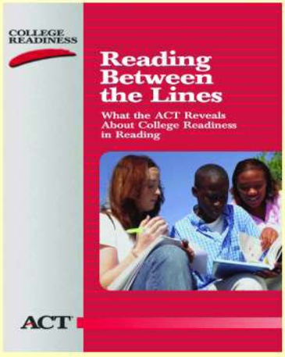
Text Complexity: Implications
On the ACT college admissions test, how did students
who met/exceeded the benchmark score
differ from
those who didn’t?
A. They could make inferences and think critically while reading
OR
B. They could answer questions associated with complex
text
Important Implication: What students can read, in terms of its complexity, is at least as important as what they can do with what they read.
2006, ACT, Reading Between the Lines

Slide 18
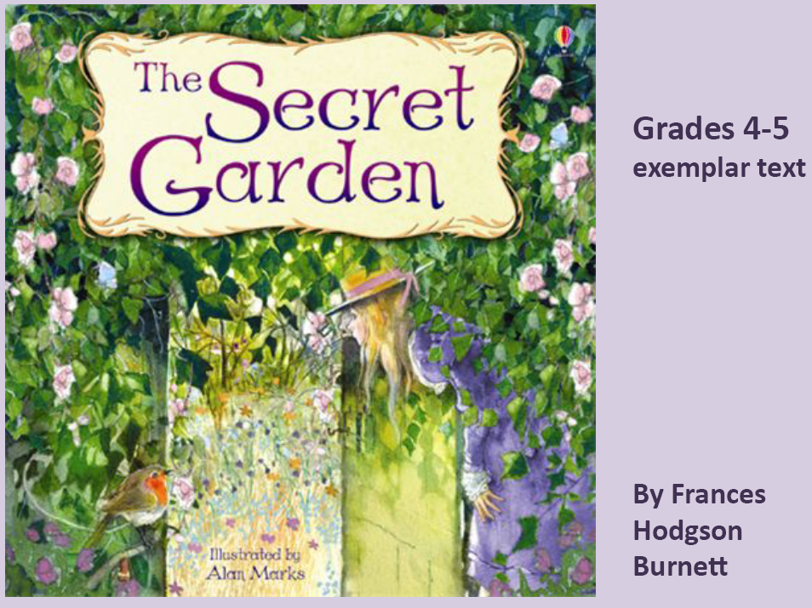
Common Core Exemplar Text Appendix B, p. 63
20 minutes
Read The Secret Garden excerpt on handout
What makes this text challenging? (engage in Think-Pair-Share)
Whole group discussion: Common Textual Challenges
Vocabulary
Background knowledge
Sentence structure
Density
Length
Figurative language
Word Choice
Teaching reading strategies is effective but is only a one-time boost
More substantial, longer-term benefits come from years of systematic instruction & constant exposure to high quality books, films, conversations
Daniel Willingham, 2007

Slide 19
Building Capacity Through Close Reading
30 minutes
Select short, worthy passages
Design the lesson so students re-read
Ask students to “read with a pencil”
Remind students to note confusions
Model the text
Discuss the text
Ask text dependent questions
RL 5.3 (example).
Compare and contrast 2 or more characters, settings, or events in a story or drama, drawing on specific details in the text (e.g., how characters interact)

Slide 20
PARCC The Partnership for Assessment of Readiness for College & Career Literacy Content Framework
PARCC Model Content Frameworks – ELA/Literacy
Reading Complex Text (5-9 short texts; 1 extended text)
Writing About Texts (routine writing; 2 analyses)
Research Project (1 research project)
Narrative Writing (1-2 narratives)

Slide 21
PARCC Literacy Content Framework
Notes:
Reading complex texts: This requires students to read and comprehend a range of grade-level complex texts, including texts from the domains of ELA, science, history/social studies, technical subjects, and the arts. Because vocabulary is a critical component of reading comprehension, it will be assessed in the context of reading passages. Both close, analytic reading and comparing and synthesizing ideas across texts are expected. Students will read short passages (a few paragraphs long) and longer or extended passages (several pages long by the time students are in high school). Nonetheless, the length of texts is less important than the focus on student engagement with appropriately complex, literary, and content rich texts to build deep knowledge about a topic (or unit of study).
Writing effectively when using and/or analyzing sources: This requires students to demonstrate the interrelated literacy skills of reading carefully and closely; gathering evidence to support an explanation, summary, claim, or comparison about what is read; and analyzing, integrating, and
presenting the supporting evidence in writing. Additionally, when using sources, students also demonstrate understanding when writing narrative descriptions of events and procedures as well as writing about experiences based on what is read. Both require students to demonstrate their understanding gained from reading skillfully and closely through cogent and coherent writing.
Conducting and reporting on research: This expands on “writing effectively when analyzing sources” to require students to demonstrate their ability to gather resources, evaluate their relevance, and report on information and ideas they have investigated (i.e., conducting research to answer questions or to solve problems).
Speaking and listening: This requires students to demonstrate a range of interactive oral communication and interpersonal skills, including (but not limited to) skills necessary for making formal presentations, working collaboratively, sharing findings, and listening carefully to the ideas of others.
Language use for reading, writing, and speaking: This requires students to have a strong command of grammar and spoken and written academic English.

Slide 22
Reading, Writing Modules
Each module suggests both the number and types of texts that students read and analyze.
Students then write about these texts either to express an opinion/make an argument or to inform/explain.
They may also use these texts as models or triggers for crafting imaginative narratives or narrative descriptions.
In addition, a research task appears in each module.
Notes:
The chart is meant to illustrate and provide context for the standards but not replace the standards themselves

Slide 23
Key Terms and Concepts: Reading, Writing, Research
Citing evidence,
Analyzing content,
Using correct grammar,
Acquiring and applying vocabulary,
Conducting discussions, and
Reporting findings

Slide 24
Planning Balanced Literacy Instruction Using the PARCC Content Framework
Decide on the topic of a thematic unit, deciding on both content and ELA (reading, writing, foundational skills, language, listening/speaking) goals
Backward map the desired results: enduring understandings, essential questions, what will kids know, understand and do (activities, assessments)
Design summative assessment and then formative assessments
Explore internet resources on topic (books, articles, videos, activities)
Develop lessons around clustered common core standards

Slide 25
Designing Your New Unit

Slide 27
Design Tip
1. What are you doing?
2. Why are you being asked to do this?
3. What will it help you do?
4. How does it fit with what you have
previously done?
5. How will you show you have learned it?

