Slide 1
Author’s Point of View

Slide 2
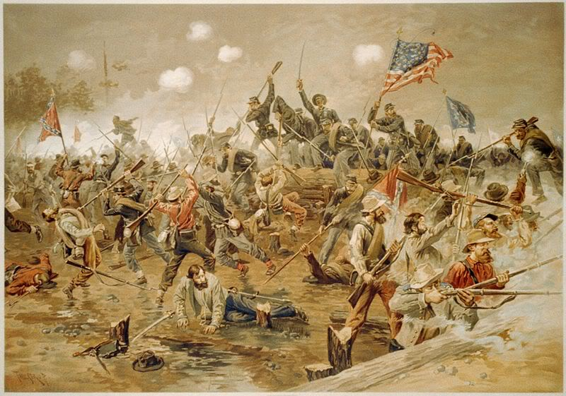
Describe this picture

Slide 3
Now imagine you were looking through the eyes of a soldier…
How would a Union Soldier view this photo?
How would a Confederate Soldier view this photo?

Slide 4
Author’s Point of View
The way the author feels about the subject that he/she is writing will affect the entire story or article.
Some ways to determine the author’s point of view are to look for:
  Word Choice
  Author’s purpose
  Background information about the author

Slide 5
Word Choice
Read the short paragraph and locate words or phrases that let you know the opinion of the writer.
My horse was wounded, but not killed. Your coat got an ugly wound near the hip, but my servant, who is very handy, has so far repaired it that it doesn’t show very much. My preservation was entirely due, as was the glorious victory, to our God, to whom be all the honor, praise, and glory. The battle was the hardest that I have ever been in, but not near so hot in its fire. I commanded the center more particularly...Whilst great credit is due to other parts of our gallant army, God made my brigade more instrumental than any other in repulsing the main attack.
  - Stonewall Jackson

